Slide 1
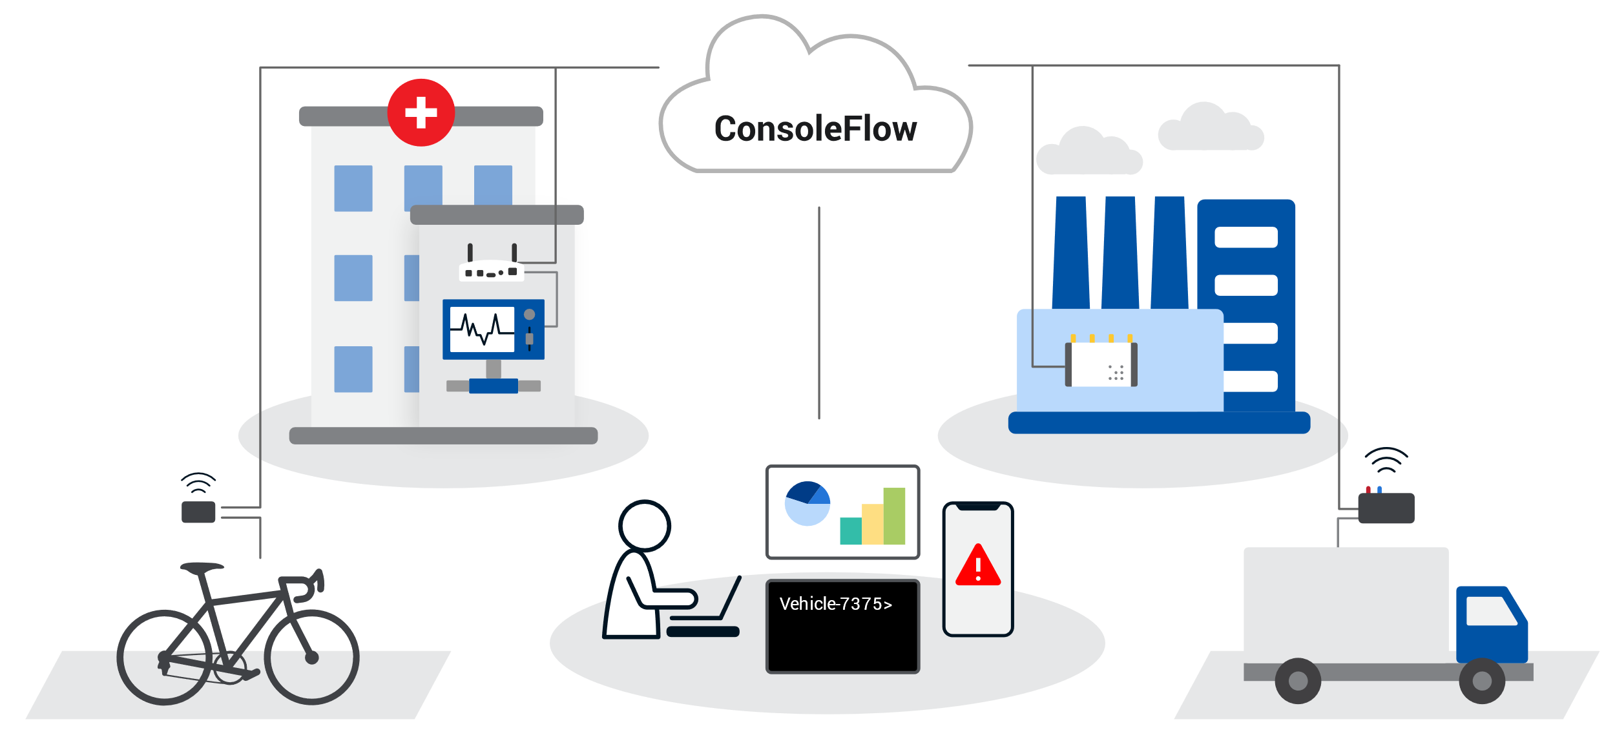
Lantronix
Turnkey
IoT Solutions.

Slide 2





IoT as a Concept
COLLECT
Ingest environmental data from an end point.
CONNECT
Access or transmit data to achieve a purpose.
COMPUTE
Normalize the data from edge to cloud and use it for simple events or complex machine learning.
COMPREHEND
Visualize and Analyze collected data from different forms to comprehend business outcomes.
CONTROL
Remote visibility and control over the end-to-end operational details of an IoT solution.
Control
Comprehend
Collect
Compute
Connect
Notes:
Defining IoT
5 key concepts that lead us to a solution.
Shows a customer we deliver.
Comprehend – Different forms - Log Files, Event Triggers, Script Results, …

Slide 3
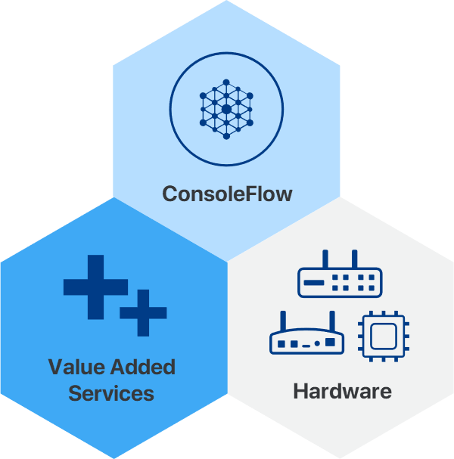
Interlocking pieces defining an IoT Solution.
ConsoleFlow
Visibility and Control in an easy single pane of glass web app. Knowing what is happening across your deployment and having the tools to respond.
Value Added Services
Go beyond just visibility and control by easily selecting the service you need. Provision cellular and VPN services for pick and go worldwide connectivity. Request engineering services for assistance with custom software and haredware projects.
Hardware
No solution is complete without matching hardware to achieve your specific requirements and real-world applicabiity.
Our Approach
Notes:
Defining an IoT Solution
3 Pieces: Single pane of glass to manage services and features to meet software and services requirements.
Harware

Slide 4
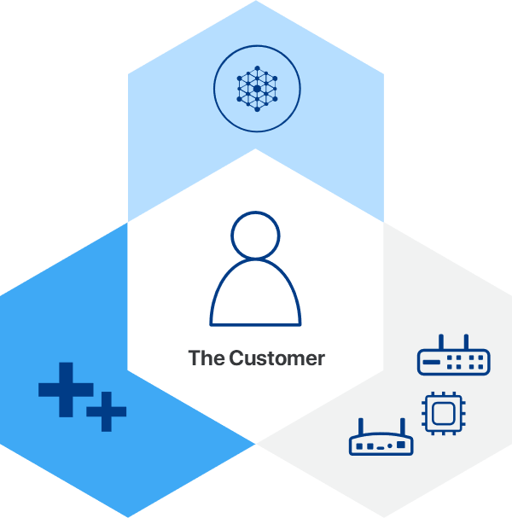
An IoT Solution Applied
The customer success is everything.
Our experience with thousands of global blue-chip customers across many vertical markets, enables us to tailor the right technical solution, delivering to the customer’s business requirements, generating successful outcomes.
Notes:
Contextual relevance of the customer.
Understanding the customer
Customer Intimacy

Slide 5
E Series Cellular Router
Software and Services

Slide 6




Get to market quickly and increase your operational efficiency with our secure ready-to-use IoT platform.
OPERATIONS
Monitor, manage, control, and troubleshoot your IoT and REM assets from anywhere in the world, at any time.
AUTOMATION
Save time and costs with automated zero-touch provisioning for remote deployed assets.
CONTROL
Visibility and Control in a single pane of glass, knowing what is happening across your deployments and having the tools to respond.

Slide 7
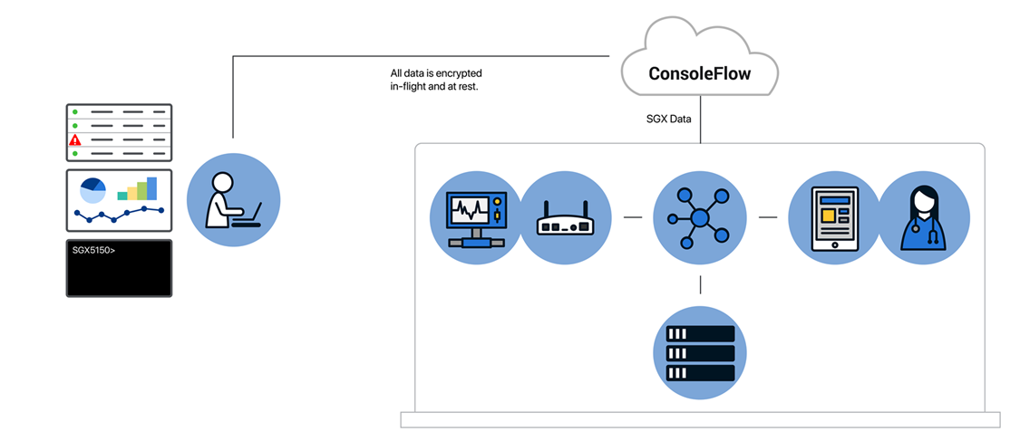
ConsoleFlow Management Platform
A single pane of glass to view and control your devices.
OPERATIONS
Aggregated status view of devices.
Create device groups for OTA ops.
Secure Remote Access to edge devices.
Log file and device configuration backup.
AUTOMATION
Zero-touch provisioning for OTA firmware & configuration updates.
Device telemetry data monitoring.
Event-driven notifications.
Run Python scripts for automated NetOps.
CONTROL
Administer and manage portals, tenants, users and services.

Slide 8







Connectivity Services
Secure global internet for everything IoT.
Multi-network redundancy
for your mission-critical apps.
North American
coverage and performance.
Secure IoT endpoint
connections and data.
Global or Carrier Connectivity and VPN security options
that can be tailored to your remote environment connectivity requirements.
Notes:
Two connectivity options: Global and North American
VPN Services

Slide 9

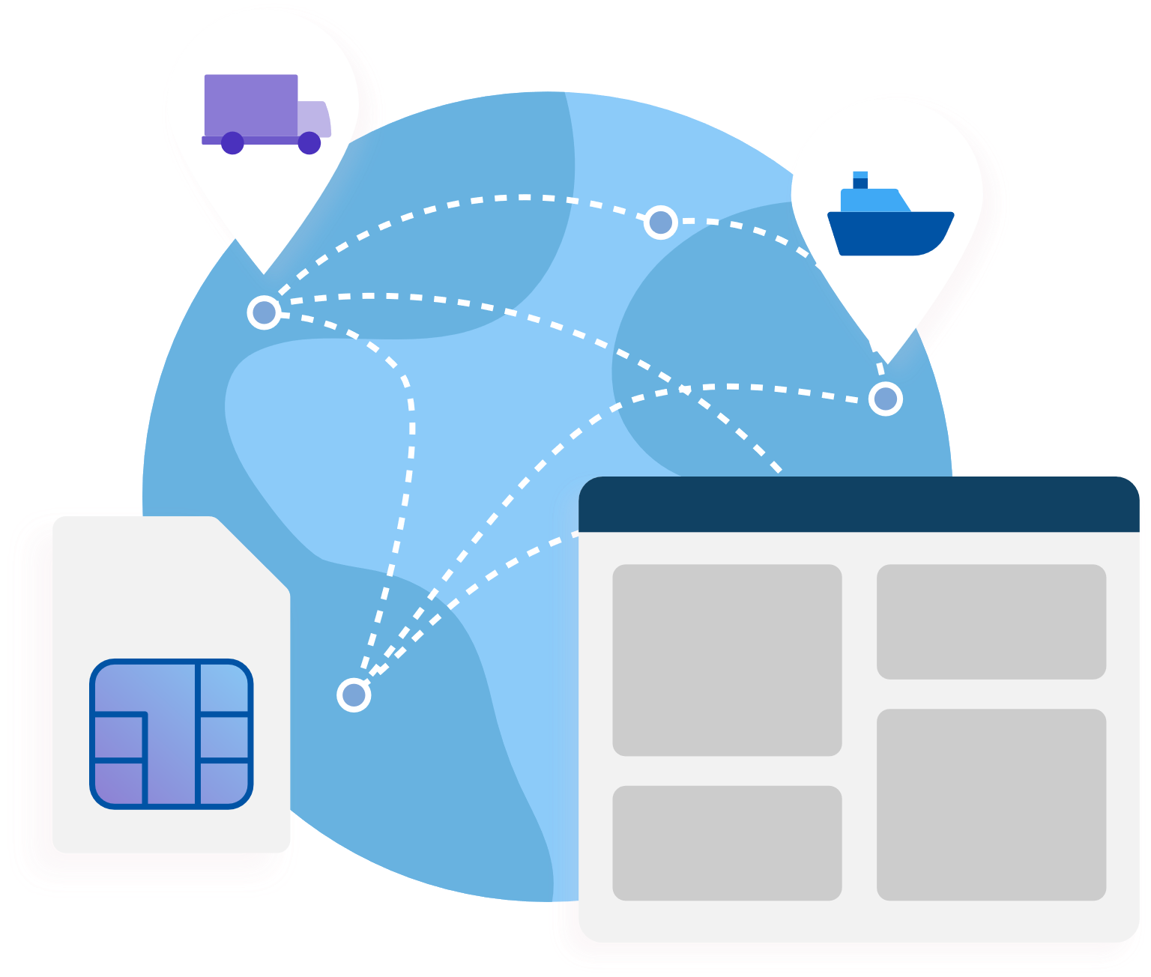
Cellular Management Platform
Easily activate, monitor, and manage your asset
SIM cards from anywhere, at any time.
SIMPLICITY
The easy-to-use cellular platform enables you to focus on operational efficiency and increasing your ROI.
ACTIVATION
Select a plan and activate SIM connectivity for your IoT assets.
MONITORING
Monitor asset connectivity status,
set important event triggers, and
receive alerts and notifications.
MANAGEMENT
Analyze your SIM usage data
over time to gain key insights.
Notes:
SIMs are managed through The Lantronix, cloud-based, cellular platform.

Slide 10

Support Services
We care about your success. Our scalable support is available for the type of care and service you require.
SUPPORT SERVICES OPTIONS
Standard
A three-year warranty is provided with 24/7 online help and can be extended with a ConsoleFlow subscription for up to seven years at no additional charge.
Premium
Extends the warranty to seven years with advanced replacement and 24/7 tech support. Requires a ConsoleFlow subscription.
Enterprise
A custom SLA is available for any additional requirements and care that are beyond our premium offering.
We can grow with you!

Slide 11
E Series Cellular Router
Hardware

Slide 12
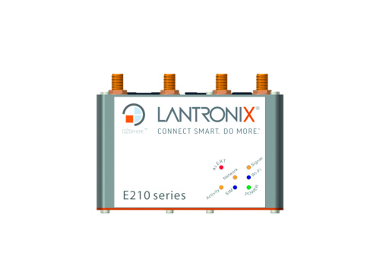
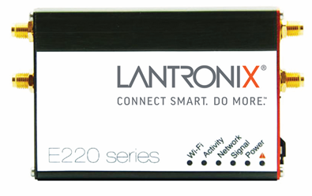
Lantronix E-Series Routers
ROUTER
POWERFUL CELLULAR ROUTER
Providing global 4G LTE cellular connectivity for a broad range of IoT devices and mobility applications.
RUGGEDIZED
Industrial Small Form Factor :
  E210 : 92.5 x 57.2 x 22.5
  E220 : 61.25 x 85.75 x 24.6
Extended Temperature Range (E220)
Intelligent self-healing connectivity
9V Low to 60V Power Range ( E220)
Optional Battery Backup
Watch Dog Management
Dual SIM (WAN Failover on E210)
E210 Series
E220 Series

Slide 13
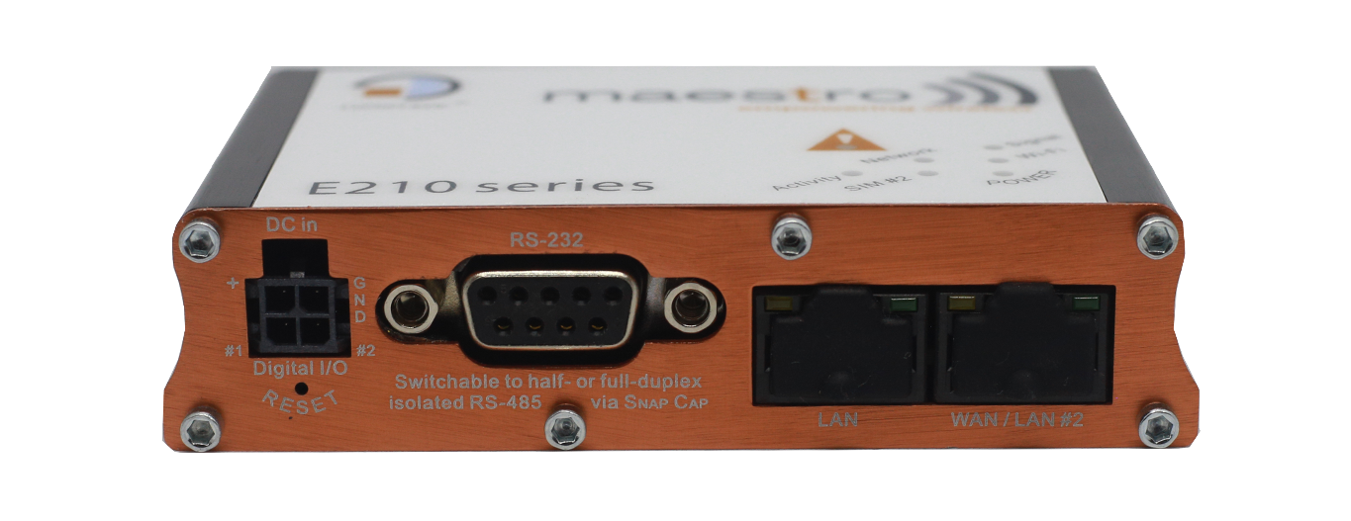
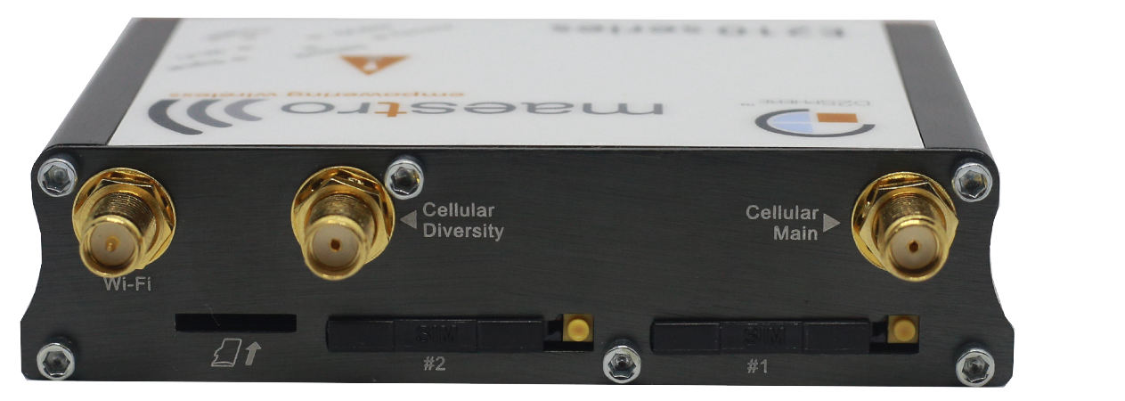
Flexible hardware configuration : E210
LTE cat 1 : The right interfaces for your solution.
Cellular Diversity
Wi-Fi
Cellular main
SD CARD
SIM#2
SIM#1
RESET
DB9
RS232
LAN
WAN/LAN#2
Digital I/Os

Slide 14
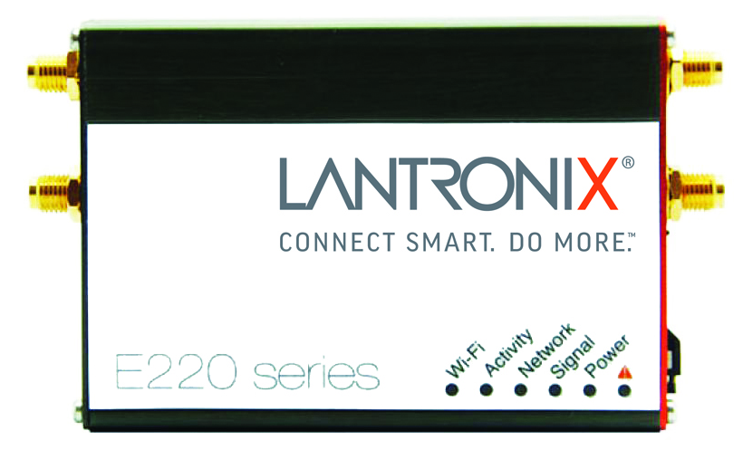
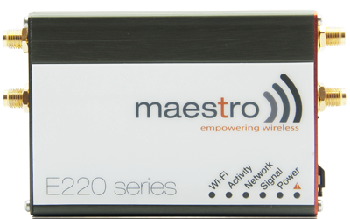
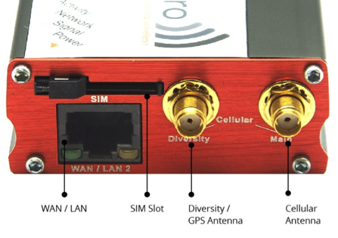
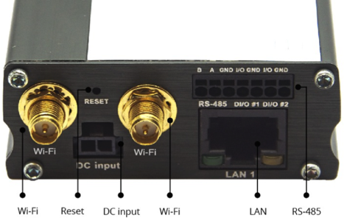
Flexible hardware configuration : E220
LTE cat 4 device : The right interfaces for your solution.
RP-SMA
Wi-Fi b/g/n antenna
SMA Cellular antenna
9V~60V DC in
On 2-pin Micro-Fit
SMA GPS/ Diversity antenna
RP-SMA
Wi-Fi b/g/n antenna
LAN on RJ45
RS-485 and 2 I/Os on 8-pin combicon
Switchable WAN/LAN on RJ45
EXTENDED
TEMP. RANGE
(-30°C to +70°C)

Slide 15

Global Connectivity Service & multiple interface
One product for the world, multiple interface
ONE GLOBAL PRODUCT
Global Cellular (3G, LTE Cat1/M1)
Support Wi-Fi 802.11
MULTIPLE INTERFACE
Ethernet WAN RJ45
Ethernet LAN RJ45
Serial Port (RS232/RS485)
2 Digital Multi-function I/O
Extendable Storage with Micro SD
Notes:
Intelligent self-healing:
Edge data Processing

Slide 16

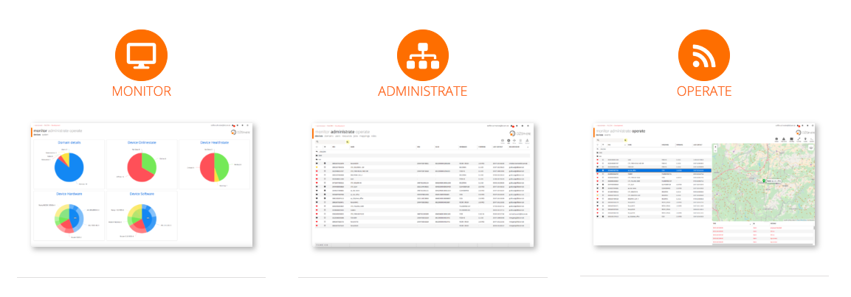
Centralized Device Management
Monitor, administrate, and operate globally distributed assets.
AUTOMATED MONITORING
Monitor device state and health in real-time and set proactive alerts for optimized data usage and network uptime
EASE OF INSTALLATION
Configure devices by groups or individually, manage access rights
REMOTE MAINTENANCE
Update devices to extend its life-span on the field with a few clicks
For more info: visit https://www.d2sphere.com/

Slide 17


Enterprise Security
Trusted, secure operation for mission-critical applications.
USER AUTHENTICATION
Local username and password
RADIUS 802.1x Authentication
Automated logout user sessions
Application and device role-based access controls
User group permissions
SECURE PROTOCOLS
WPA2-Enterprise (WPA3) (EAP-TLS, EAP-TTLS, EAP-PEAP, EAP-FAST)
Secure Socket Layer
TLS 1.0, 1.1, 1.2
SSH and SSL configurable for
SHA-2 and higher
SNMP v3 with AES encryption
FIPS 140-2 Level 1 compliance
IPsec VPN Connectivity
VPN Profiles
GENERAL FEATURES
Zone-based Firewall Network Access
Packet filtering by MAC and IP address & port number (firewall)
Password protected system configuration files
Enable / disable the web server and other non-required services
System and user log files
LANTRONIX SECURITY TEAM
Proactively manages all security threats and tracks CVE alerts; address all issues immediately with a formal escalation process.

Slide 18
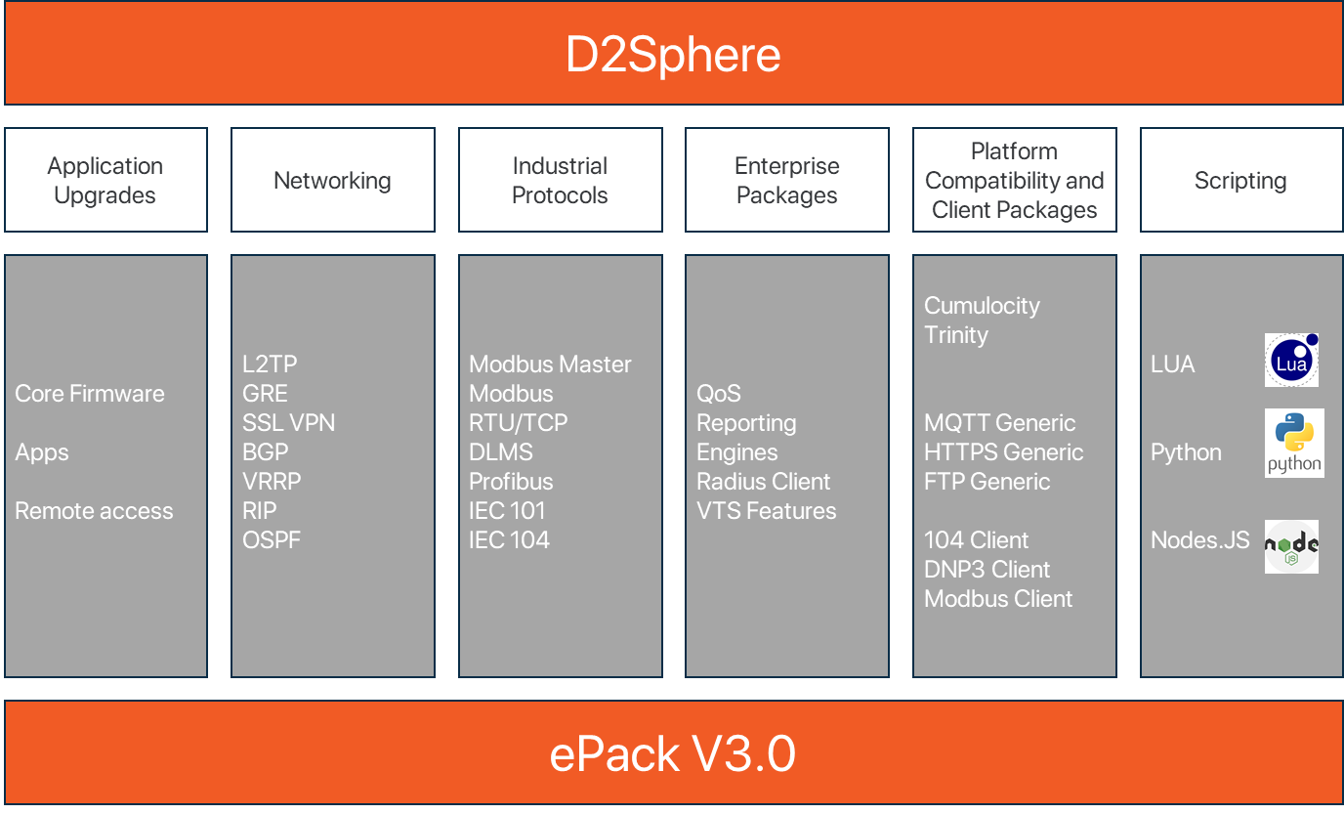
Software capabilities

Slide 19
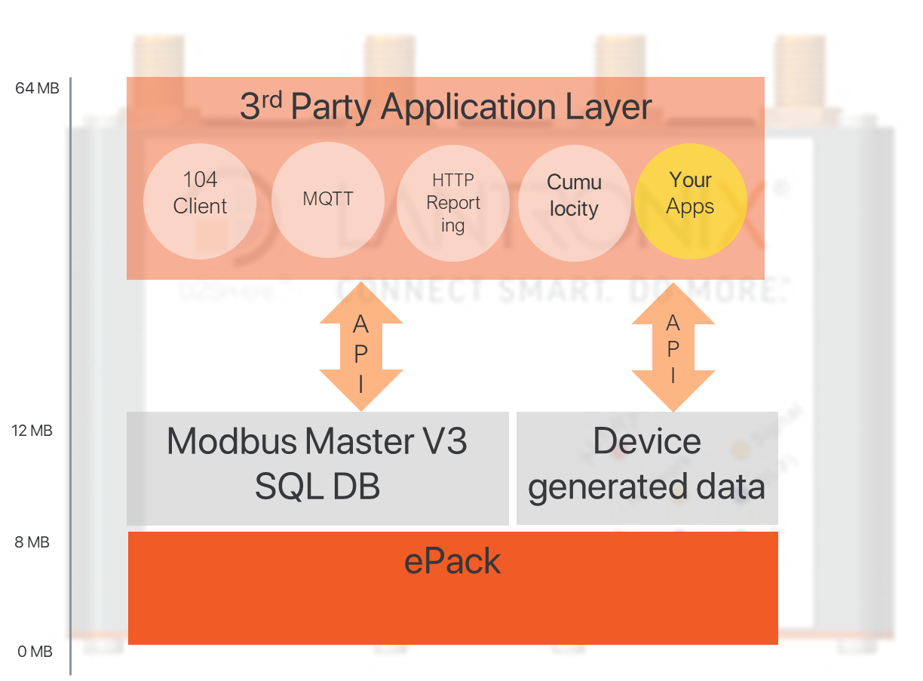
Customer Specific Applications

Slide 20





Industrial protocol support
Edge data processing for your legacy industrial equipment
INDUSTRIAL PROTOCOL CONVERSION
Modbus RTU/TCP
Modbus Master
DLMS
IEC101/104
ROADMAP
DNP3
Ethercat
Profibus
OPC-UA
Modbus Master Architecture
Modbus RTU
Device
Modbus RTU Poll request
Cellular Network
Head End
RS 485 link
HTTP / HTTPS / FTP CSV
Modbus Master
Modbus RTU
Device
Notes:
Intelligent self-healing:
Edge data Processing

Slide 21
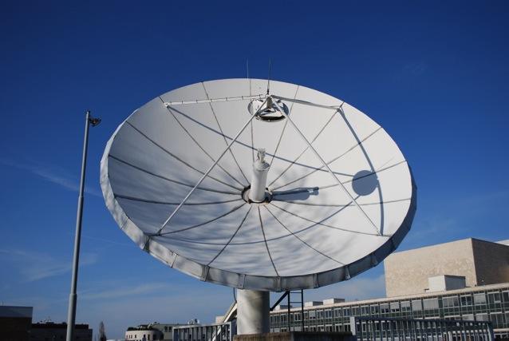

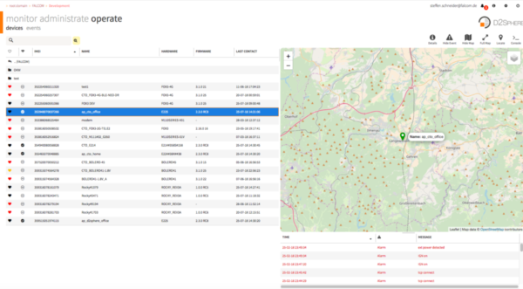



Ease your deployment
Locate your router in real time
Embedded GNSS
Embedded concurrent GNSS support :
GPS
Glonass
Beidu
Track your router anywhere any time

Slide 22
Thank You

Slide 23
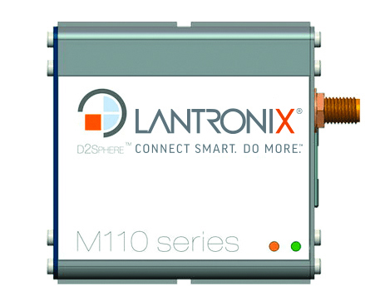
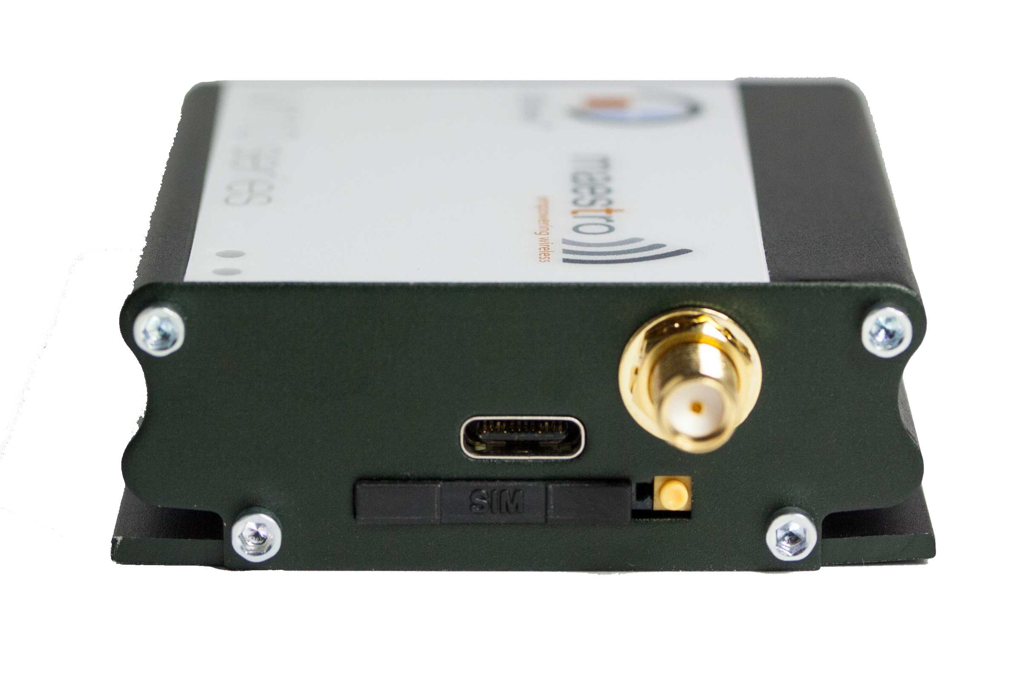
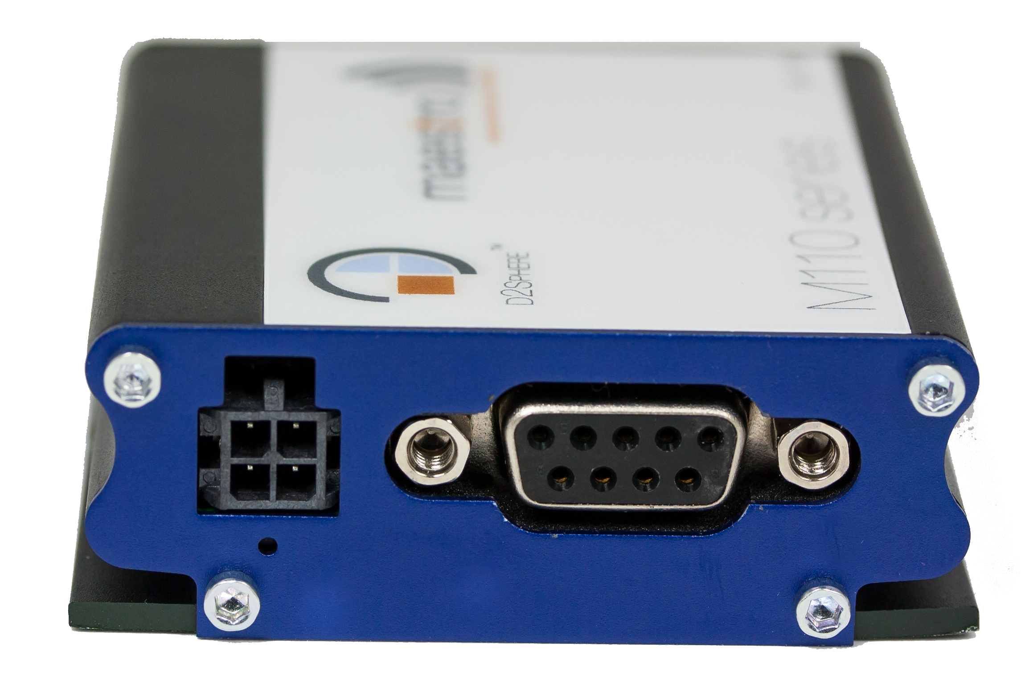
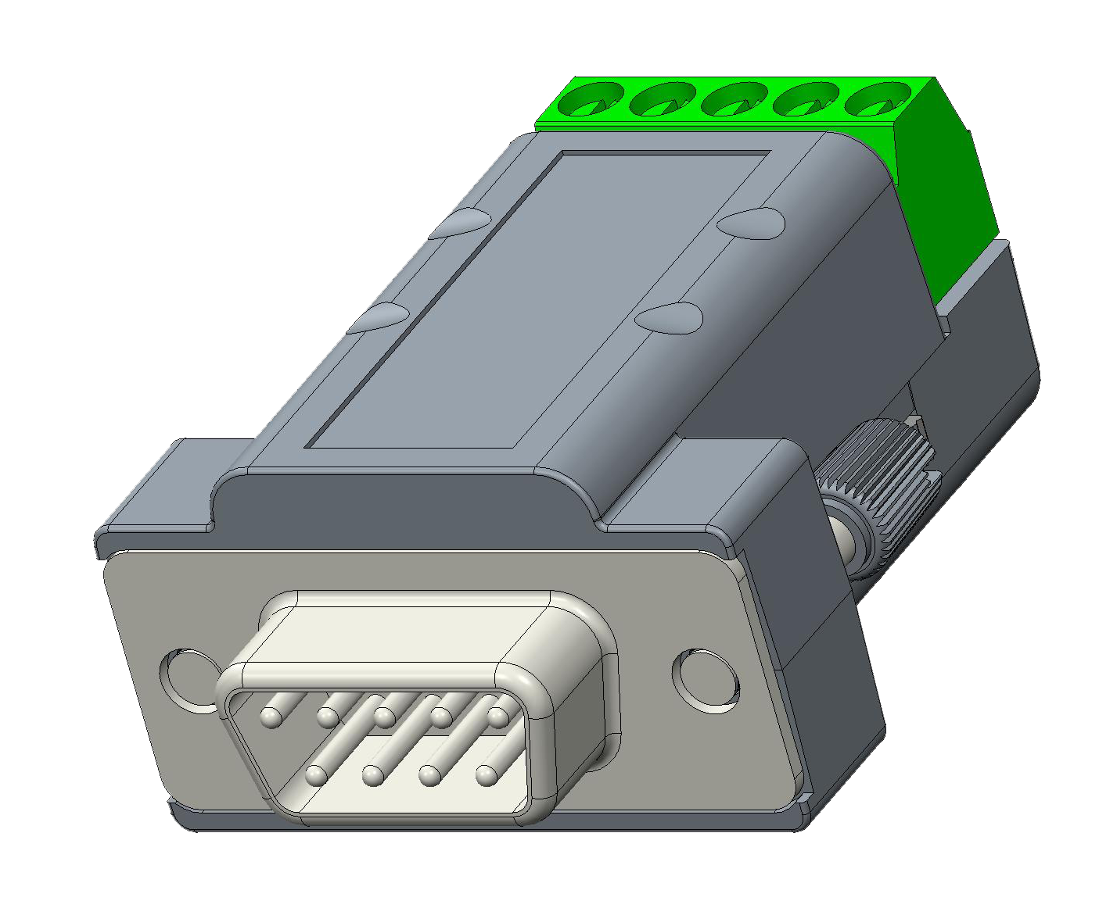
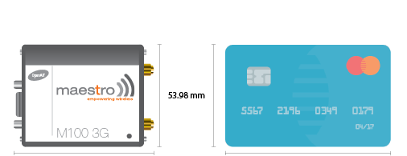


Serial Modems M110 Series
DB9
RS232
SMA female
Cellular main
Two 2-way versatile I/Os
SIM Tray
Mini-SIM
Mini-USB
Cellular 2G, 3G, 4G Cat 4, Cat 1, Cat M, NB OIT
RS-232 – switchable to 485 via Snap-cap
2 X Versatile I/Os
Extended Temp. Range -30°C to +70°C
Powered by mPack
Low Power Consumption
60 x 60 x 22mm Ultra Small Factor
Direct connection to equipment
On selected Models

