Slide 1
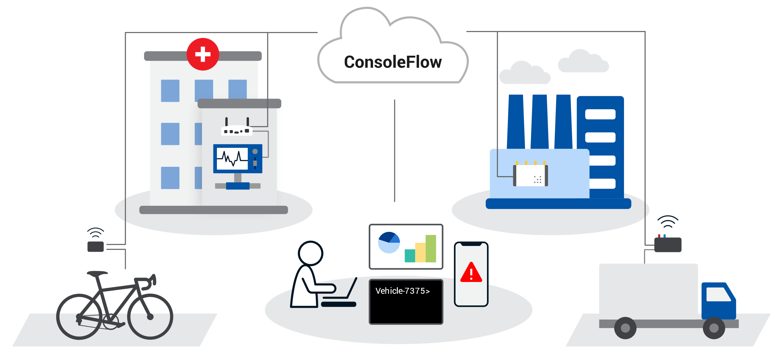
Lantronix
Turnkey
IoT Solutions.

Slide 2
IoT as a Concept
COLLECT
Ingest environmental data from an end point.
CONNECT
Access or transmit data to achieve a purpose.
COMPUTE
Normalize the data from edge to cloud and use it for simple events or complex machine learning.
COMPREHEND
Visualize and Analyze collected data from different forms to comprehend business outcomes.
CONTROL
Remote visibility and control over the end-to-end operational details of an IoT solution.
Control
Comprehend
Collect
Compute
Connect
Notes:
Defining IoT
5 key concepts that lead us to a solution.
Shows a customer we deliver.
Comprehend – Different forms - Log Files, Event Triggers, Script Results, …

Slide 3
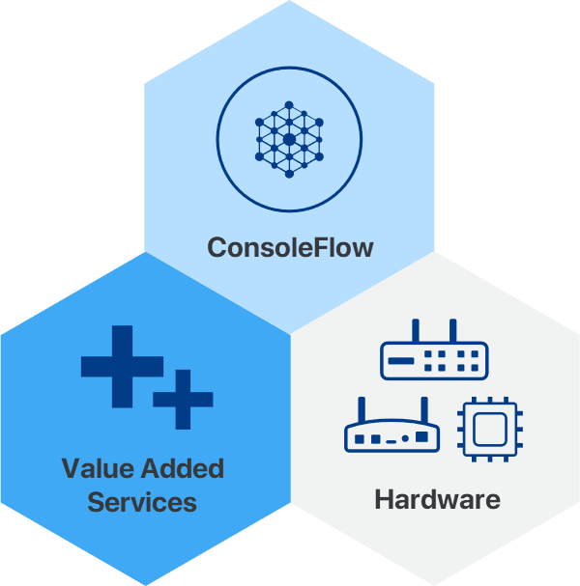
Interlocking pieces defining an IoT Solution.
ConsoleFlow
Visibility and Control in an easy single pane of glass web app. Knowing what is happening across your deployment and having the tools to respond.
Value Added Services
Go beyond just visibility and control by easily selecting the service you need. Provision cellular and VPN services for pick and go worldwide connectivity. Request engineering services for assistance with custom software and haredware projects.
Hardware
No solution is complete without matching hardware to achieve your specific requirements and real-world applicabiity.
Our Approach
Notes:
Defining an IoT Solution
3 Pieces: Single pane of glass to manage services and features to meet software and services requirements.
Harware

Slide 4
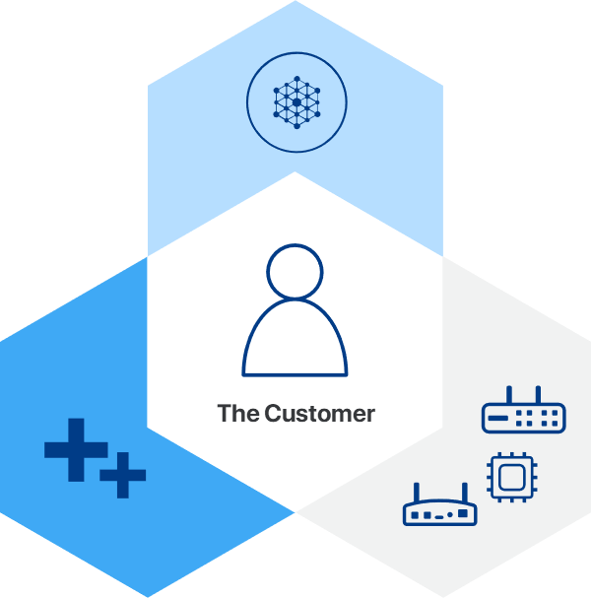
An IoT Solution Applied
The customer success is everything.
Our experience with thousands of global blue-chip customers across many vertical markets, enables us to tailor the right technical solution, delivering to the customer’s business requirements, generating successful outcomes.
Notes:
Contextual relevance of the customer.
Understanding the customer
Customer Intimacy

Slide 5
Mobility Software and Services

Slide 6
Get to market quickly and increase your operational efficiency with our secure ready-to-use IoT platform.
OPERATIONS
Monitor, manage, control, and troubleshoot your IoT and REM assets from anywhere in the world, at any time.
AUTOMATION
Save time and costs with automated zero-touch provisioning for remote deployed assets.
CONTROL
Visibility and Control in a single pane of glass, knowing what is happening across your deployments and having the tools to respond.

Slide 7
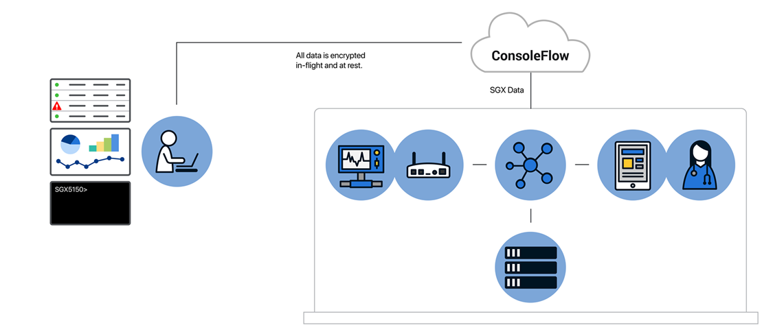
ConsoleFlow Management Platform
A single pane of glass to view and control your devices.
OPERATIONS
Aggregated status view of devices.
Create device groups for OTA ops.
Secure Remote Access to edge devices.
Log file and device configuration backup.
AUTOMATION
Zero-touch provisioning for OTA firmware & configuration updates.
Device telemetry data monitoring.
Event-driven notifications.
Run Python scripts for automated NetOps.
CONTROL
Administer and manage portals, tenants, users and services.

Slide 8
Connectivity Services
Secure global internet for everything IoT.
Multi-network redundancy for your mission-critical apps.
North American
coverage and performance.
Secure IoT endpoint
connections and data.
Global or Carrier Connectivity and VPN security options that can be tailored to your remote environment connectivity requirements.
Notes:
Two connectivity options: Global and North American
VPN Services

Slide 9
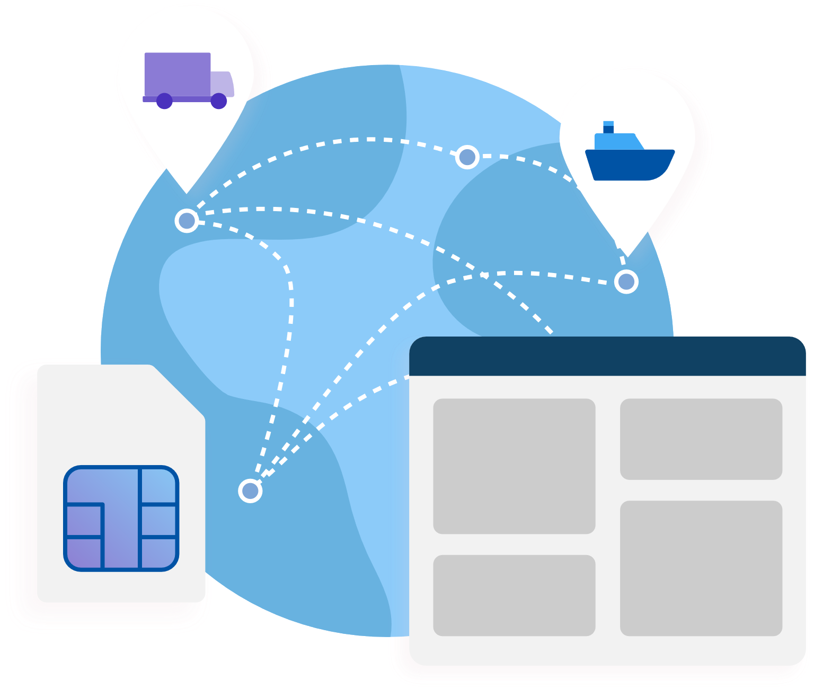
Cellular Management Platform
Easily activate, monitor, and manage your asset SIM cards from anywhere, at any time.
SIMPLICITY
The easy-to-use cellular platform enables you to focus on operational efficiency and increasing your ROI.
ACTIVATION
Select a plan and activate SIM connectivity for your IoT assets.
MONITORING
Monitor asset connectivity status,
set important event triggers, and
receive alerts and notifications.
MANAGEMENT
Analyze your SIM usage data over time to gain key insights.
Notes:
SIMs are managed through The Lantronix, cloud-based, cellular platform.

Slide 10
Support Services
We care about your success. Our scalable support is available for the type of care and service you require.
SUPPORT SERVICES OPTIONS
Standard
A three-year warranty is provided with 24/7 online help and can be extended with a ConsoleFlow subscription for up to seven years at no additional charge.
Premium
Extends the warranty to seven years with advanced replacement and 24/7 tech support. Requires a ConsoleFlow subscription.
Enterprise
A custom SLA is available for any additional requirements and care that are beyond our premium offering.
We can grow with you!

Slide 11
Mobility Hardware

Slide 12
Solutions Select the right IoT device matching your solution.
Cellular
Routers
Telematic
Devices
Wi-Fi
Gateways
Device
Servers
Providing global 4G LTE cellular connectivity for a broad range of IoT devices and mobility applications.
Comprehensive hardware and software networking solution providing extensive protocols and programmability.
Centralized management through a single pane-of-glass from anywhere, and at anytime.
Highly customizable and compact vehicle telematics devices with 24/7 connectivity.
Centralized Management platform to monitor, maintain, and control devices remotely.
Designed to meet automotive standards specifications and demands.
Rapidly and securely connect industrial IoT assets and data to the enterprise network.
Multiple device interface options quickly deliver business-critical asset data securely to the public or private cloud network.
Centralized management platform with zero touch provisioning for easy automated deployments.
Enterprise-grade device server for securely
integrating ‘edge’
equipment into a network.
Serial-to-Ethernet device server, providing quick and easy Ethernet connectivity to virtually any device or machine.
Complete device server application with full IP stack and web server.

Slide 13
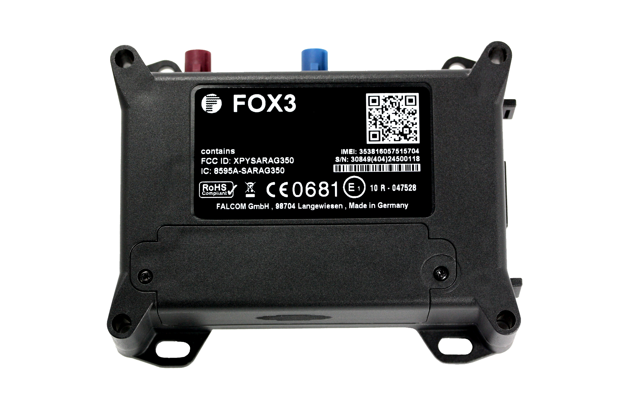
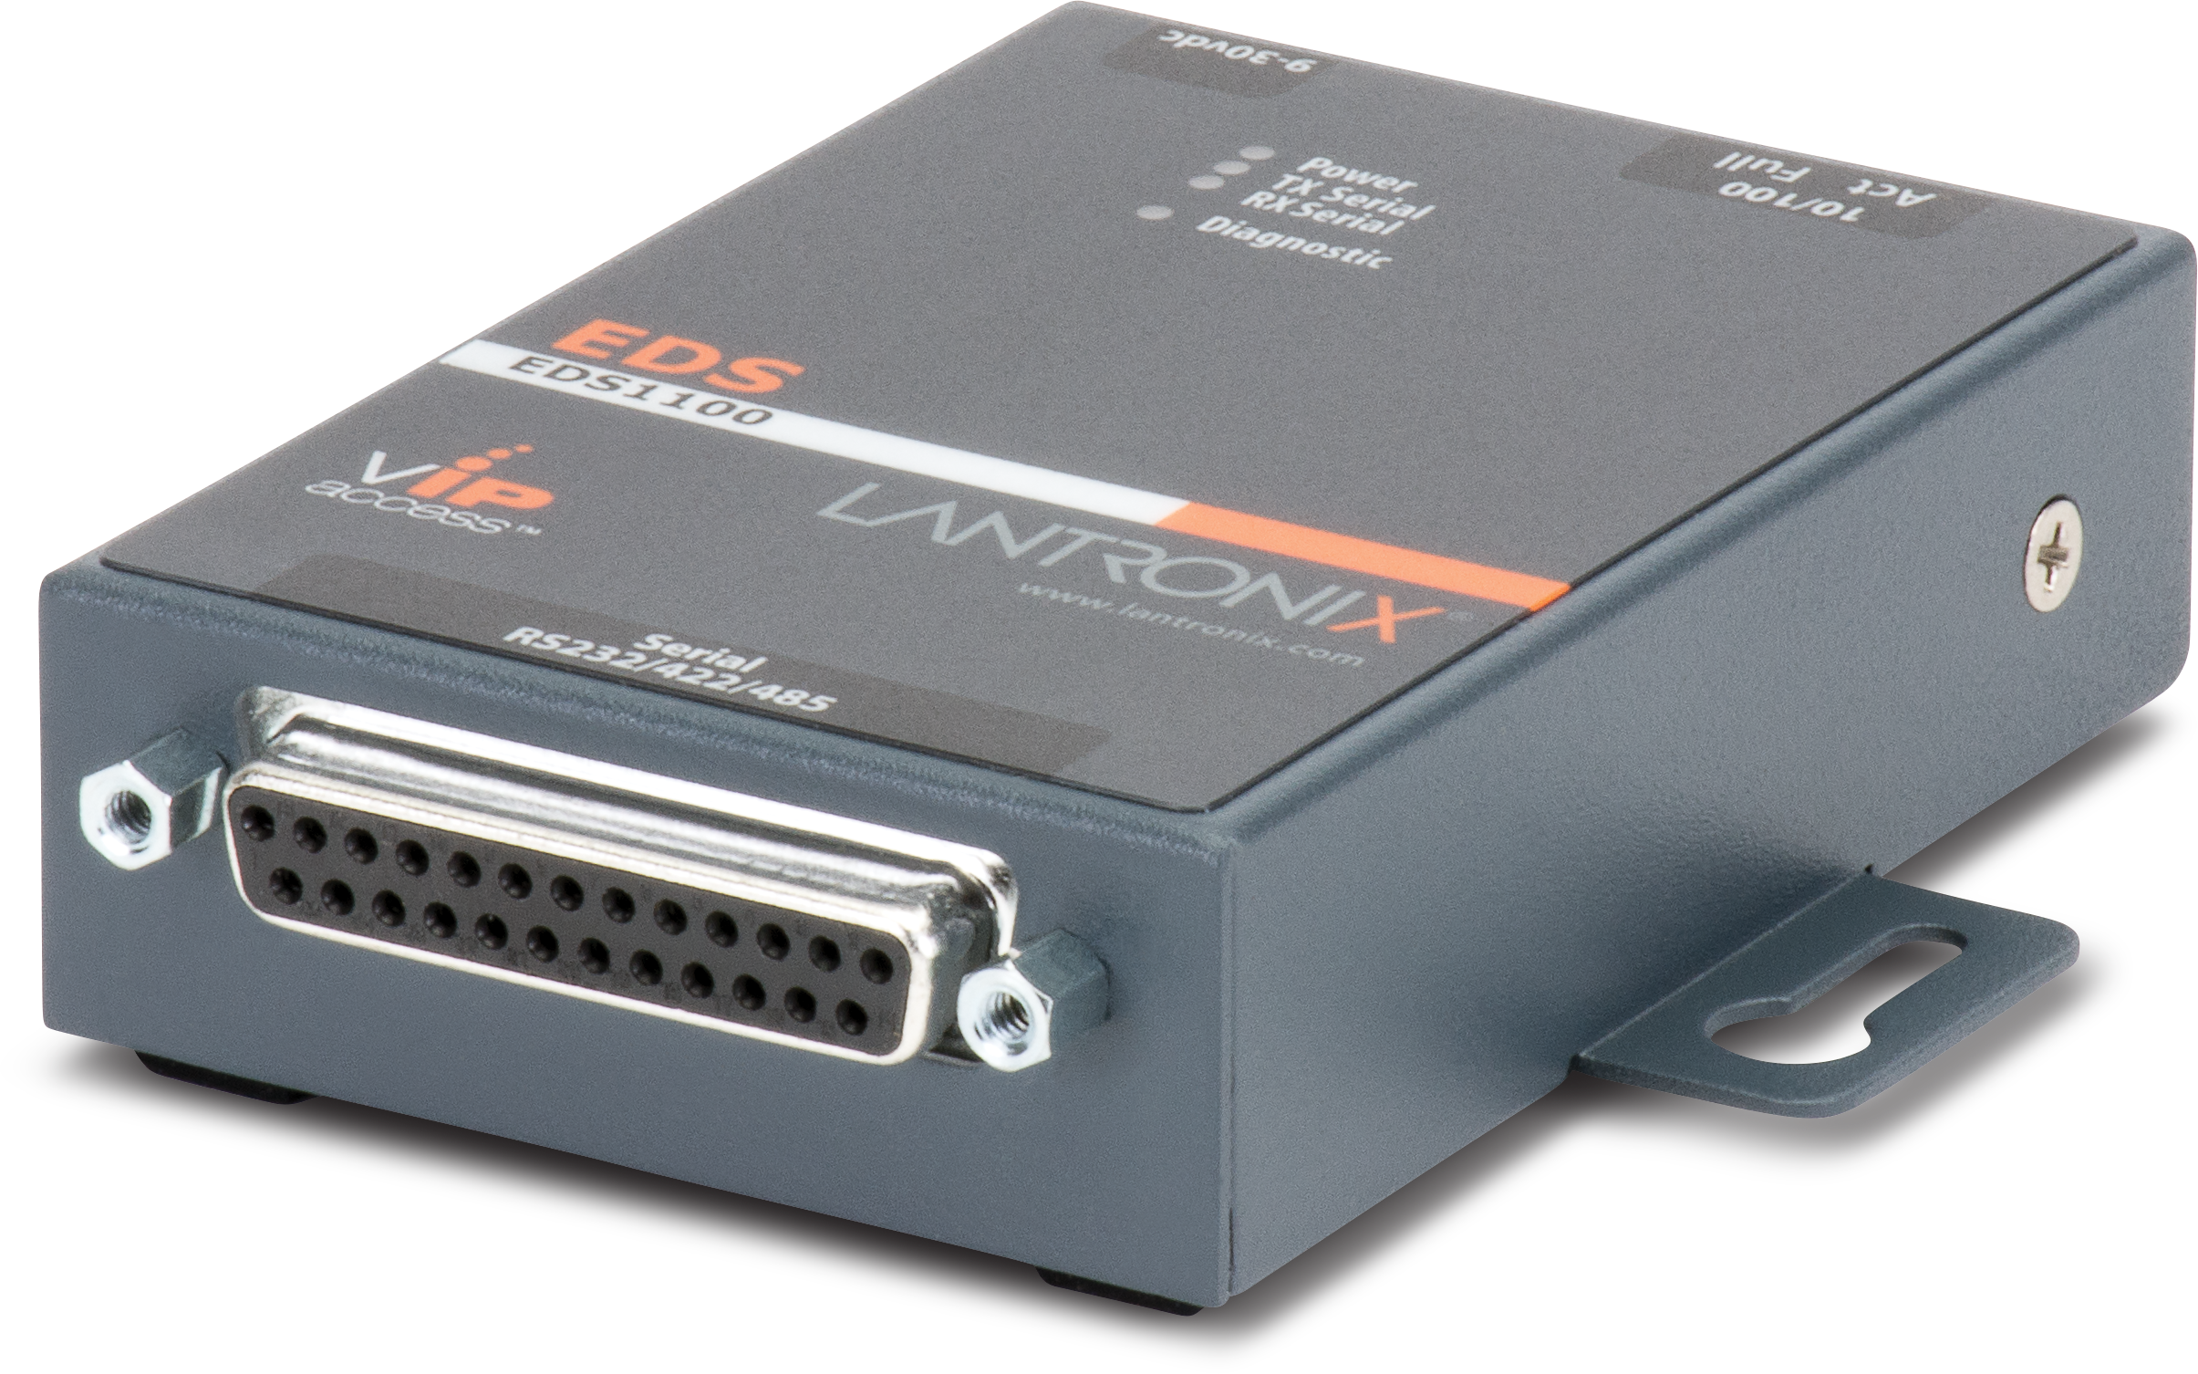
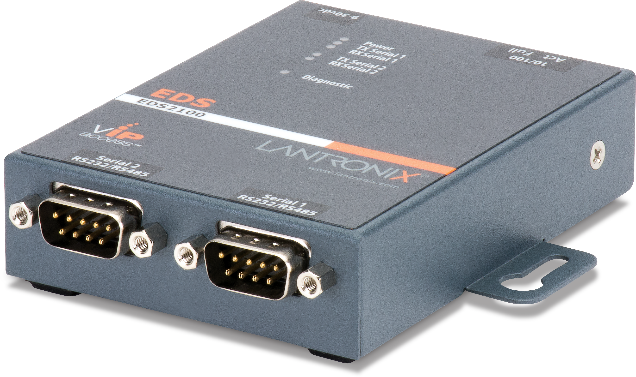
Lantronix
The intelligent IoT product portfolio.
Cellular
Routers
Telematic
Gateway
Medical
Gateways
Device
Servers
SGX™ 5150
EDS 4100
E210 Series
FOX3 Series
SGX-MD™ 5150
EDS 3000
E220 Series
BOLERO40 Series
EDS-MD
EDS 1100/2100

Slide 14
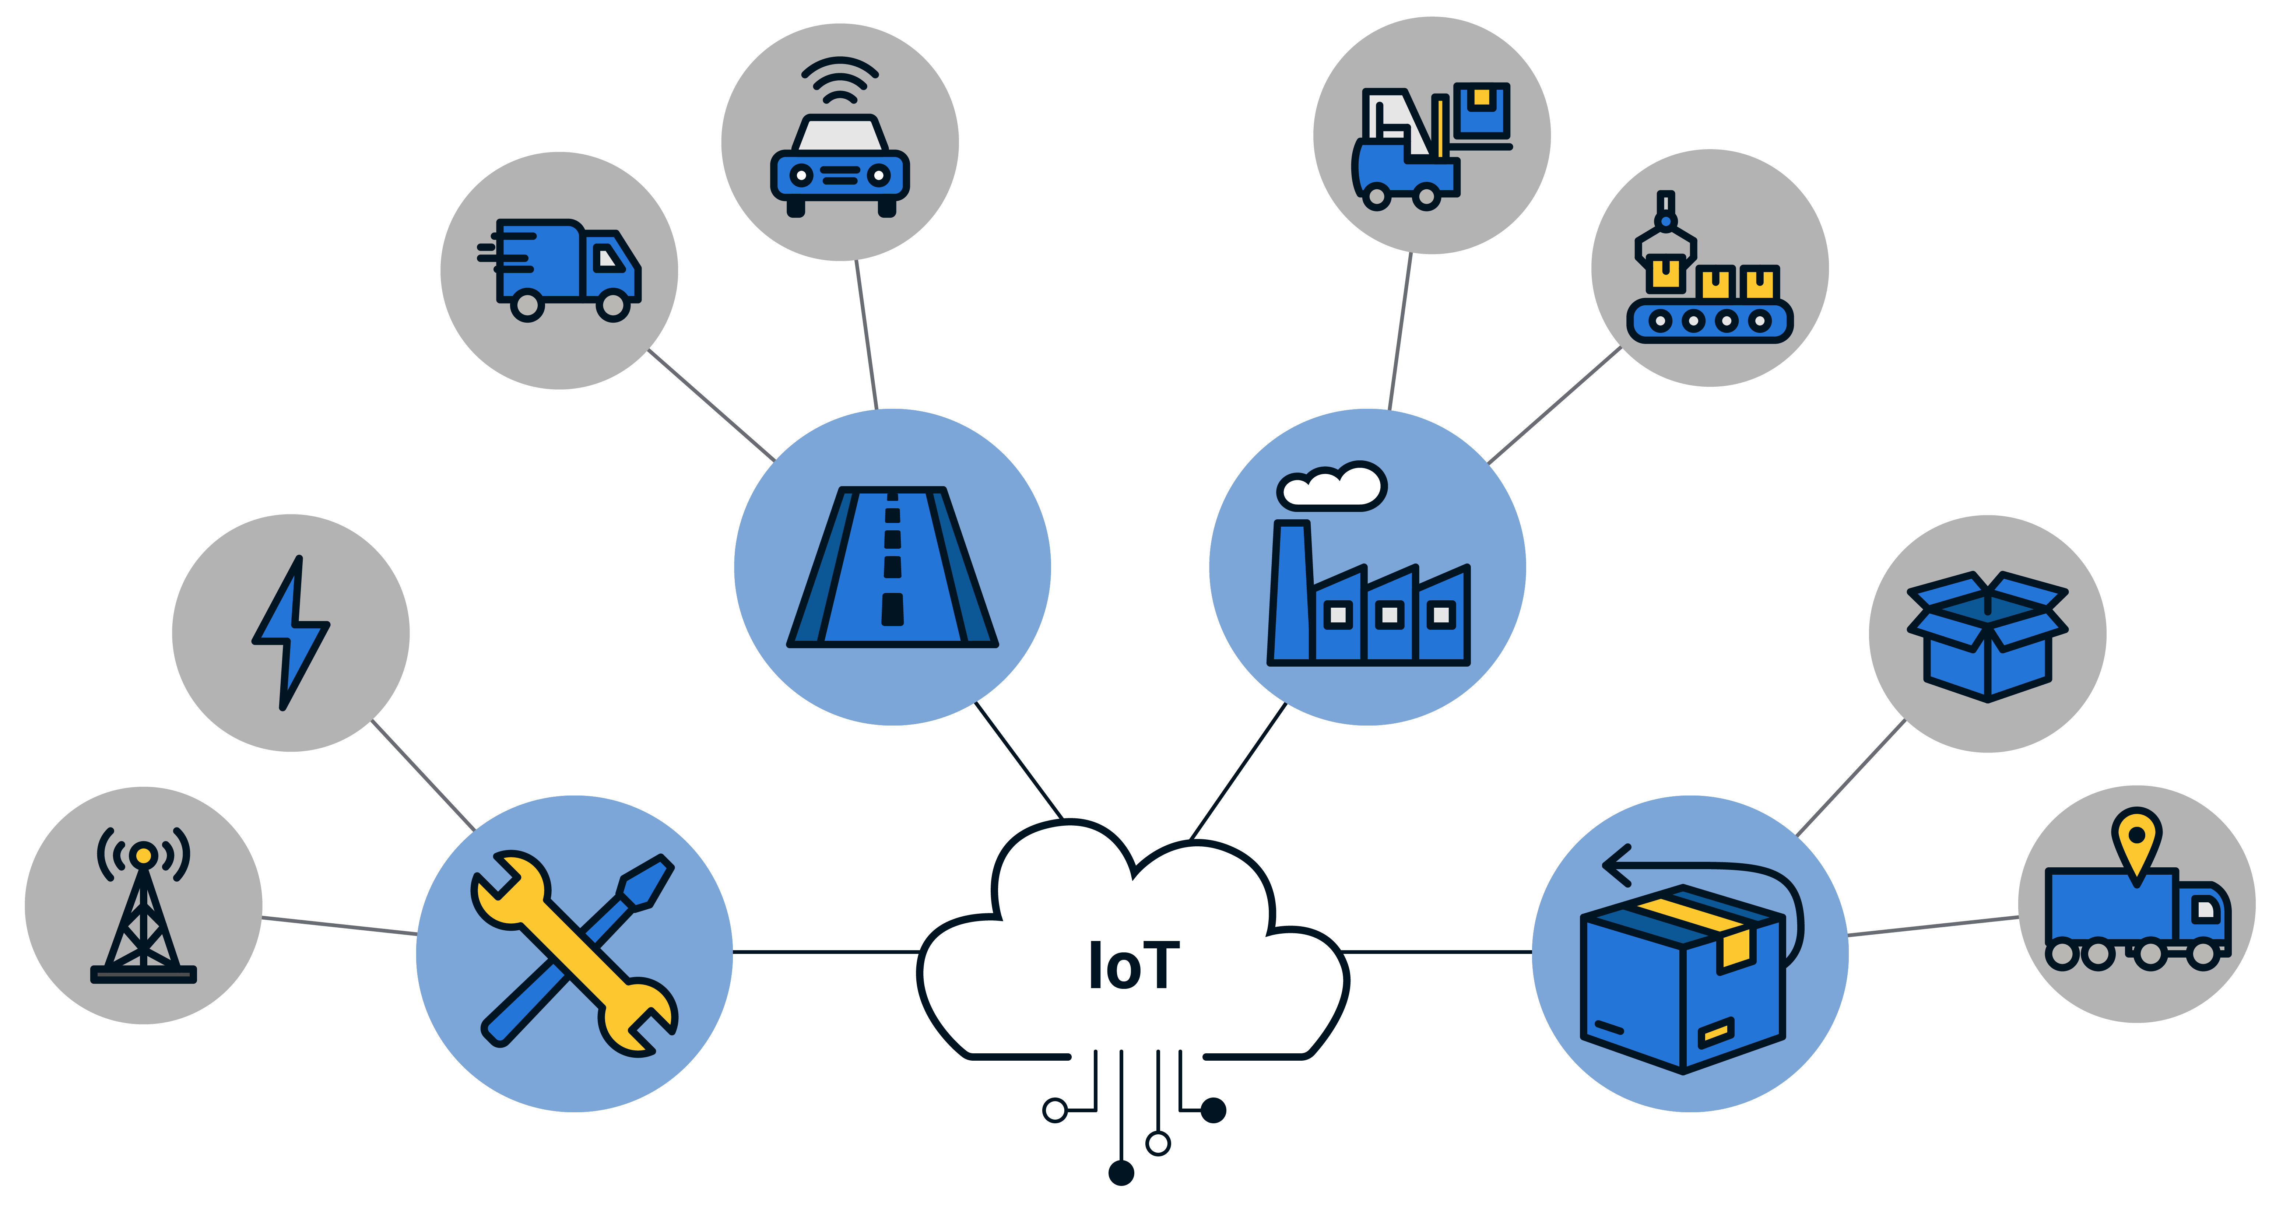
Markets and Verticals
Solutions for an extensive number of applications.
AUTOMOTIVE
Vehicle tracking and monitoring
for connected trucks and cars.
MANUFACTURING
Industrial automation, material handling, and production line processing.
LOGISTICS
Asset location and tracking from source to destination.
UTILITIES
Monitoring and metering of energy resource operation

Slide 15
Enterprise Security
Trusted, secure operation for mission-critical applications.
USER AUTHENTICATION
Local username and password
RADIUS 802.1x Authentication
Automated logout user sessions
Application and device role-based access controls
User group permissions
SECURE PROTOCOLS
WPA2-Enterprise (WPA3) (EAP-TLS, EAP-TTLS, EAP-PEAP, EAP-FAST)
Secure Socket Layer
TLS 1.0, 1.1, 1.2
SSH and SSL configurable for
SHA-2 and higher
SNMP v3 with AES encryption
FIPS 140-2 Level 1 compliance
IPsec VPN Connectivity
VPN Profiles
GENERAL FEATURES
Zone-based Firewall Network Access
Packet filtering by MAC and IP address & port number (firewall)
Password protected system configuration files
Enable / disable the web server and other non-required services
System and user log files
LANTRONIX SECURITY TEAM
Proactively manages all security threats and tracks CVE alerts; address all issues immediately with a formal escalation process.

Slide 16
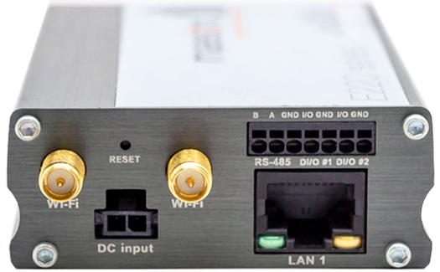
A Ruggedized Industrial Router
Extensive capability in a small form factor.
Global LTE and LTE-M1 cellular with dual SIMs for WAN Failover and Failback.
Centralized management for your globally distributed assets.
Load-balance data flows across Ethernet, Wi-Fi, and Cellular interfaces.
Vehicle and asset location tracking
with GPS.
Develop custom applications and scripts for your vertical solution.
Industrial protocols and data logging with
edge data processing.
Notes:
Intelligent self-healing:
Edge data Processing

Slide 17
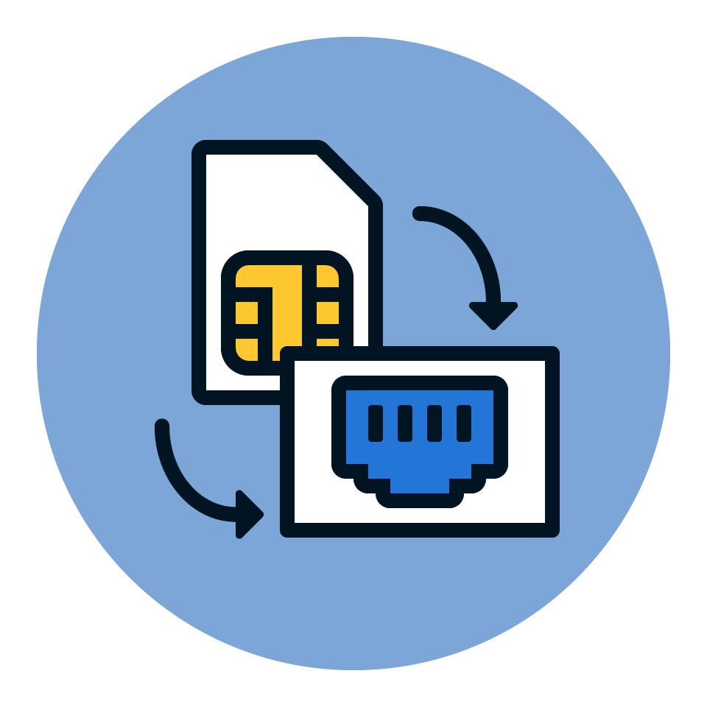
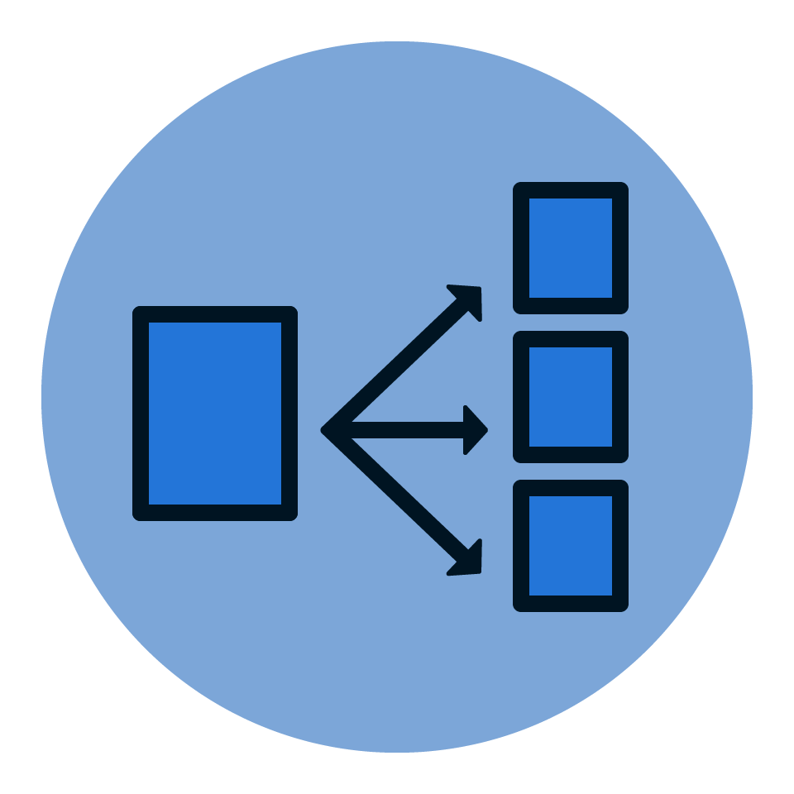
Enterprise Continuity of Service
Ensuring network resilience and connectivity.
AUTOMATED FAILOVER
Automated WAN-side failover and failback ensures continuity of service.
When the WAN fails over, it will
failback according to how the
priorities and conditions are set.
LOAD BALANCING
Manage Ethernet, Wi-Fi, and
Cellular flows to load balance
across each of the interfaces.
More than one WAN can be used at the same time to divide the data according on the rules set.
WAN AFFINITY
Set up WAN affinity rules to manage traffic in your network. Users with specific bandwidth needs are associated with a WAN sources.
Connection types are managed to prioritize the bandwidth use.

Slide 18
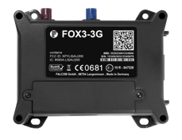
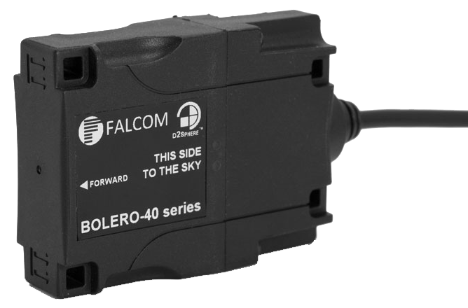
A Ruggedized Global Tracking Device
Extensive feature set for complex asset and fleet solutions.
Vehicle tracking and positioning with global LTE connectivity
using multi- channel GNSS.
Centralized management and tracking for your globally distributed assets.
Vehicle driver logbook history, trip management, eco-drive, driver behavior and crash detection.
Sensor interfaces
with multi-function
I/O and 1-wire.
Programmability with timers, event triggers, counters, geofences,
and waypoints.
Vehicle diagnostic interfaces on CAN bus, and BLE for indoor tracking.
Notes:
Intelligent self-healing:
Edge data Processing

Slide 19
Fleet and asset management
Customize vehicle telematics for your solution.
Configurable reporting rate based on motion, time and input state changes.
Periodic or threshold-based alerts.
Data logging out-of-coverage
locations and events.
Driver Behavior alerts on braking, acceleration, cornering, zone reporting including crash detection.
Triggers when discrete actions exceed limit.
Power Management based on elapsed time and/or monitored state change.

Slide 20
A reliable Wi-Fi gateway
Multiple hardware interfaces for flexible connectivity solutions.
5G 802.11ac Wi-Fi,
RS-232, RS-422, RS-485, USB Device and Host modes, Ethernet, Bluetooth/BLE.
Centralized management for your globally distributed assets.
15KV serial port ESD protection, Industrial temperature range, rugged metal enclosure DIN rail mounting clip
Multiple Power Options with PoE, 9-30 VDC
or 9-24 VAC.
Access, monitor and control equipment over the IP network
Replace dedicated PCs and/or modem line.
Supports Modbus master or slave, Modbus/TCP to Modbus RTU/ASCII gateway, Multi-Master connections to a DF1 device Ethercat master.
Notes:
Intelligent self-healing:
Edge data Processing

Slide 21
Secure medical device connectivity
Deliver encrypted data from the medical device to the station servers while providing real-time network connectivity status.
SECURE CONNECTIONS
All data is encrypted from the medical, so it is secure in-flight to the medical device data center server application.
NETWORK DEVICE STATUS
The SGX 5150 802.11ac gateway delivers the best in-house network resilience.
A comprehensive set of network status information is provided for each medical device connectivity.
Encrypted In-flight

Slide 22
Rugged metal device servers
Connect industrial devices securely to the local or public cloud.
Secure network connectivity for virtually any RS-232/422/485 device with a serial interface.
Centralized device management through a single pane of glass.
Industrial grade temperature ranges.
Programmable computing platform supporting CLI,
XML, and RSS.
Delivers flexible power configurations, eliminating the need for costly power converters.
Enables new business intelligence from network-enabled equipment.
Notes:
Intelligent self-healing:
Edge data Processing

Slide 23
Digital Transformation
Collaborating and understanding your KPIs.
Enterprise network infrastructure
topologies and assets are all different.
At Lantronix, we work closely with
your team to understand your
challenges and critical pain points.
We identify an out-of-band
solution that can maintain the
highest level of business continuity
and helps improve overall
operational efficiency.
Notes:
Slide 1:2
Transition to B4B discussion.
Perspective: Discuss to get a clear perspective of your customer’s business goals (digital transformation), specific challenges and pain points
Analysis: Understand the customer’s product use cases and how these challenges and pain points affect the products and them as a company.
Collaboration: Come to an agreed upon Lantronix solution that solves their problems and delivers to their digital transformation objectives (operational efficiency, remote site autonomy, reduced downtime, etc.).
Execution: Deliver the products and services in a coherent, procedural and timely manner.
Win more follow-on business!

Slide 24
The Lantronix Team
We’re here to help.
Business Outcomes
Solution Experts
A Trusted Partner
Our solutions can mitigate your Panic time when everything else fails.
Network operators can securely access assets, anywhere, any time.
Eliminate travel expenses and improve operational efficiency.
We offer a complete line of hardware, software, and services to manage your network infrastructure assets.
Configure a solution that solves your challenges and drives your key
business objectives.
We listen closely and dialogue with
you, our customer, to fully understand the challenges and pain points that you are looking to solve.
We collaborate to configure the best solution that solves your challenges and achieves your specific business goals.
Notes:
Slide 2:2
This is who we are, what we deliver and how we can help. Extra emphasis “A Trusted Partner”.

Slide 25
Thank You

