Slide 1
Global Leader
in Edge AI &
Industrial IoT
April 2026
LTRX:NASDAQ

Slide 2

Forward-Looking Statements
This Presentation contains forward-looking statements, including statements concerning our business and product development plans and strategies, the perceived benefits of our products and corporate acquisitions, and our future growth and financial performance. Any statement relating to our plans, goals, expectations or any future event should be considered a forward-looking statement. While we have based our forward-looking statements on our current assumptions and expectations, forward-looking statements are not guarantee of future performance and are subject to substantial risks and uncertainties. As a result, our actual results could differ materially from those indicated in our forward-looking statements, and you should not rely on any of these forward-looking statements.
Important factors that could cause our actual results and financial condition to differ materially from those indicated in the forward-looking statements include, but are not limited to, volatility in global economic conditions; product development and marketing risks; risks related to manufacturing and international operations; difficulties associated with our suppliers, distributors or resellers; intense competition in our industry; changes in applicable U.S. and foreign government laws, regulations, and tariffs; risks associated with acquisitions, divestitures, mergers, or joint ventures; intellectual property and cybersecurity risks; the outcome of legal proceedings; and other risks and uncertainties described in “Risk Factors” in our Annual Report on Form 10-K filed with the SEC, as well as in our other filings with the SEC. In addition, new risks emerge from time-to-time and we cannot predict all future risks or assess the impact of all risks to our business. Our forward-looking statements are based on our view as of the date they are made. Except as required by law, we expressly disclaim any intent or obligation to update any forward-looking
statements after the date hereof because of new information, future events or otherwise.
Some of the financial information and data contained in this Presentation, including non-GAAP operating expenses, non-GAAP net income (loss), and non-GAAP earnings (loss) per share, have not been prepared in accordance with United States generally accepted accounting principles ("GAAP”). We believe that the use of these non-GAAP financial measures provides an additional tool for investors to use in evaluating historical or projected operating results and trends in and in comparing our financial measures with other similar companies, many of which present similar non-GAAP financial measures to investors. We do not consider these non-GAAP measures in isolation or as an alternative to financial measures determined in accordance with GAAP. The principal limitation of these non-GAAP financial measures is that they exclude significant expenses and revenue that are required by GAAP to be recorded in our financial statements. In addition, they are subject to inherent limitations as they reflect the exercise of judgments by management about which expense and revenue items are excluded or included in determining these non-GAAP financial measures. In order to compensate for these limitations, management presents historical non-GAAP financial measures in connection with GAAP results. A reconciliation of the non-GAAP financial measures to the corresponding GAAP financial measures, along with important information regarding our disclosure of the non-GAAP financials, is provided in the Appendix to this Presentation.
Presentation contains our trademarks, service marks, trade names & copyrights and other companies which are property of their respective owners.

Slide 3
Lantronix at a Glance
A Technology Growth Engine
Key Differentiators
Accelerating AI-Ready Edge Deployments: Developing leading-edge products and software to accelerate Edge AI & manage complex workflows
Seamless Edge AI Platform: An integrated solution delivering a robust platform for optimized model performance, supporting the rapid development, deployment and acceleration of edge AI solutions
Powering Network Infrastructure: Secure and resilient LTE and 5G WAN connectivity at the edge, supporting teams highly dependent on cloud-based and on-prem devices
Ultra-Low Latency AI Inference: Powers real-time decision-making for edge devices, critical for drone autonomy and surveillance
Robust IP and Edge Leadership: Portfolio accelerates secure, compliant solutions for embedded compute
Edge AI Hardware Expertise: Capturing multi-year growth in a ~$60B market by 2030¹
Company Snapshot
Proven Expertise & Capabilities
$117M
TTM
Revenue
43.6%
TTM
Gross Margin
$4.6M
TTM
Adjusted EBITDA
$23M
12/31/2025
Cash Balance
Global Leader in Edge AI & Industrial IoT
Proven Ability to Scale Across Large,
Distributed Asset Networks
LTRX
NASDAQ
~300
Full-Time Employees
U.S.
Headquarters
1989
Year Founded
Expanding Global Footprint with Leading
Defense and Commercial Drones
¹ Edge AI Hardware Market projected at $58.9B by 2030 (MarketsandMarkets, 2025)

Slide 4



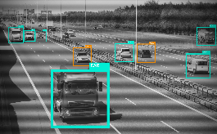
Combining Compute and Connect
One Platform, One Ecosystem, Endless Solutions
Compute
Connect
Enabling Edge Intelligence with Compute & Connect
Scalable Solutions
Operational Efficiency
Real-Time Decisions
20+ years of embedded hardware expertise
Proven pivot: Serial device servers to cellular gateways & compute modules
Now delivering AI-ready edge solutions with orchestration and remote device management

Slide 5
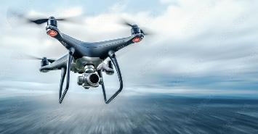


Positioned at the Center of Three Secular Edge AI Markets
Scalable Edge AI platforms driving expansion across defense, infrastructure, and enterprise
Aerospace & Defense
Defense Drone Supercycle Underway
Critical Infrastructure Monitoring
Infrastructure Digitization Accelerating
Enterprise
Edge AI Upgrade Cycle Underway
$1B+ Pentagon Drone Dominance program¹
Pentagon procurement scaling at unprecedented pace
Edge AI enabling autonomous mission platforms
NDAA/TAA compliance creates structural moat
Grid modernization fueling large-scale IoT deployments
Edge analytics reducing downtime and operational risk
Resilience mandates sustaining infrastructure spend
Multi-year infrastructure investment cycle underway
AI workloads driving enterprise upgrade cycle
Edge compute improving security, uptime, and cost efficiency
Digital transformation accelerating distributed edge adoption
Enterprise Edge AI spend growing at double digits
1. On February 3, 2026, the Department of War announced 25 vendors to compete in Phase 1 of the Drone Dominance Program (DDP), with $1.1B committed over four phases of the program.

Slide 6
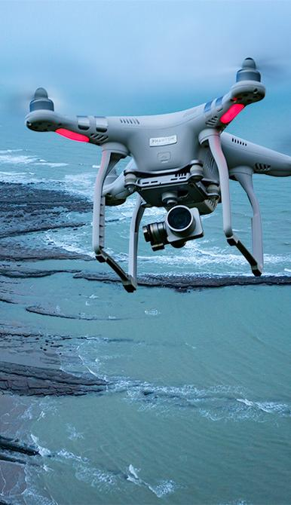
Aerospace & Defense
Powering defense & public safety with secure Edge AI solutions
Lantronix Solutions
Platform Partner in DoW Drone Dominance Program: Lantronix partners/customers included in $1.1B program deploying 200,000+ units through 2027—validating platform approach versus component suppliers
NDAA/TAA-Compliant U.S. Supply Chain: Full compliance positions Lantronix to capture accelerating federal spending in secure, U.S.-based drone technologies
Mission-Critical Edge AI: Percepxion™ software enables secure real-time monitoring, autonomous navigation, and on-device threat detection for defense operations
Defense & Public Safety Wins
U.S. Army SRR Program: Active Red Cat Teal Black Widow shipments with expansion into software and next-gen platforms
Public Safety Entry - Flock Safety: First Drone-as-First-Responder design win opens new vertical with 18,000+ U.S. law enforcement agencies
AI Threat Detection - Safe Pro Group: Real-time ground hazard detection demonstrates edge AI differentiation for autonomous navigation applications
Note: The applications on this page are representative and not wholistic of all business covered within the vertical.
1. National Defense Authorization Act (NDAA) and Trade Agreement Act (TAA).

Slide 7

Strategic Snapshot: Engaging the $13B+ DoW Budget for UAS applications
Defense Focus
Focusing on group 1-2, short-range reconnaissance drones align with current unmanned DoW funding
Commercial Edge AI
Aerora + Teledyne FLIR partnerships for autonomous navigation and industrial inspection
Market Backdrop
$13B+ FY26 DoW spend, and the current DoW Drone Dominance Program indicates favoring of U.S.-based companies, creating an unprecedented demand for secure U.S. solutions
Lantronix Advantage
Camera + compute expertise, NDAA/TAA¹ compliance, U.S.-based supply chain
Positioned for Multi-Year Growth
Engaged with 15+ defense and commercial drone vendors globally
National Defense Authorization Act (NDAA) and Trade Agreement Act (TAA).

Slide 8

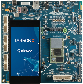
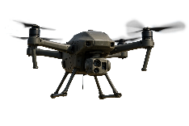
Platform Driven Edge Drone Camera Solutions
Strategic repositioning to defense AI applications
1
Defensible Market Position
Relied on by top defense, industry, and business leaders
Reference Solutions
Multi-spectral imaging
EO + IR cameras
Sensor fusion
Advanced communications
AI video pipelines
Design services
Strategic Differentiation
Proven expertise in AI/ML, imaging, security, camera + compute, and connectivity
Revenue Potential
Drones could reach 15 – 20% of Lantronix's total sales in FY2027
Edge Processing
Reduced latency, faster response to input, and a counter to data transfer jamming
2
Original Equipment Manufacturers (OEM)
Open-Q SOMs
Custom solutions
Flight control and payload systems
North American Supplier: NDAA/TAA -compliant
Low SWaP (Size, Weight, and Power)
The civil UAS market is set to become the most promising sector this decade, driven by the rise of commercial applications and the increasing adoption of UAVs by governments for roles in border security and public safety.
1
— RGSBR Research, Unmanned Aerial Vehicles Industry Report (Sep 2025)
National Defense Authorization Act (NDAA) and Trade Agreement Act (TAA).

Slide 9


Trusted Partner in Next-Gen Edge Solutions
Partnering with Leading Innovators in Edge AI and Thermal Imaging
Strategic Positioning: A strategic platform partner in Edge AI and Industrial IoT, Lantronix leverages its compute and connectivity solutions
Innovative Pipeline: Developing next-gen Edge AI programs in collaboration with Qualcomm
Scaling Advantage: Recognized as Qualcomm’s key western scaling partner, enabling accelerated reach
Strategic Application: Collaboration with Teledyne FLIR (thermal camera) on next-gen AI-enabled solutions in autonomous systems, drones, surveillance, and robotics
Technology Foundation: Solutions powered by Lantronix Open-Q™ SOMs built on Qualcomm’s Dragonwing platform
Differentiated Capability: Enables advanced thermal image signal processing (ISP) and AI at the edge with greater flexibility for device innovation

Slide 10

Critical Infrastructure Monitoring
Enabling infrastructure upgrades at national, state, and regional levels
Tier-1 U.S. Mobile Network Operator (MNO)
Solution that allows MNOs to monitor the generators that are in each cell tower site
Edge IoT Gateway Solutions
First AI-enabled IoT Edge gateways for low-voltage grid solutions
Grid Resiliency
Smart utilities are improving grid resiliency and flexibility with Edge AI
Public transport systems requiring real-time IoT data & decision-making
Smart devices empower city and state agencies to capture data, enabling more efficient management of transportation systems
Note: The applications on this page are representative and not wholistic of all business covered within the vertical.

Slide 11
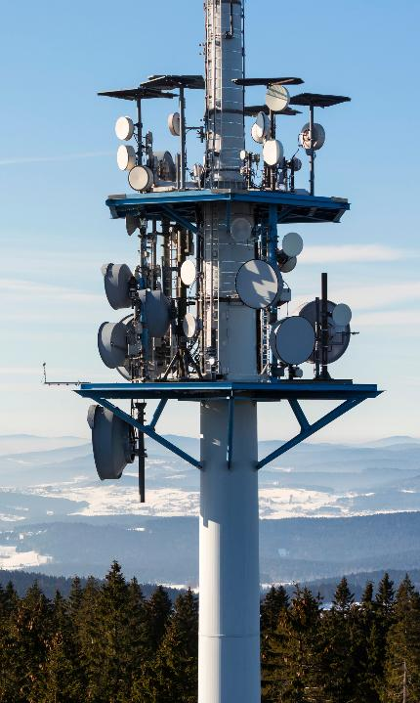
Strategic Snapshot: Tier-1 U.S. Carrier Win in Critical Network Resilience
Digitally transforming the management of power systems
Tier-1 Contract
Multi-year nationwide contract for backup power management + cloud-based software platform
Percepxion Software
Solution leverages Lantronix’s Edge gateways and Percepxion™ software
Remote Oversight
Demonstrates proven ability to scale across large, distributed asset networks
Large Scale
Enables remote oversight and data-driven service to 50,000+ cell sites
Focused on expanding beyond monitoring generators into other high-value applications within the tower (e.g., backup power banks and rectifiers)
24/7/365 Capabilities
24/7 monitoring of remote sites with automated alerts for outages, tampering or security threats, along with comprehensive audit capabilities

Slide 12

Enterprise
Enabling data centers & enterprise networks with improved resiliency
Out-of-Band Management Solutions
Keeps critical operations functioning with rapid enterprise network recovery
Target Segments and Value Delivered
Across banking, logistics, aviation, federal, and healthcare, Lantronix's independent, policy-enforced OOB plane keeps critical operations recoverable, auditable, and automated
Reduction in Support Time
Reduces support time and mitigates costly network outages, cutting mean time to repair (MTTR)
Cybersecurity
Enhances cybersecurity compliance requirements across complete networks
Select Enterprise Customers Include:
Abbott Healthcare, Bank of America, Motorola Solutions
Note: The applications on this page are representative and not wholistic of all business covered within the vertical.

Slide 13
Sequential Revenue Growth Driving Higher-Margin Mix
Diversified revenue base with increasing software and platform contribution
Sequential growth supported by improving revenue mix
FY26 Drone revenue expected to be in the range of $8 million - $12 million
Software & services mix expanding, targeting ~2× increase over ~18 months
Platform model driving higher-margin recurring revenue
$30.5E¹
$ in millions
1. Represents the midpoint of the company’s revenue guidance of $28.5 million to $32.5 million. Q3 FY26E guidance issued on February 4, 2026

Slide 14
Margin Stability Driving Predictable EPS Expansion
Lean cost structure converting growth into operating leverage
Operating leverage emerging as revenue scales
Gross margins stable at 43–45%, supporting consistent profitability
Lean cost structure driving EPS growth as incremental revenue converts efficiently to earnings
Each ~$10M of incremental revenue expected to drive ~$0.08–$0.10 in non-GAAP EPS
1
1. Q3 FY26E Non-GAAP EPS represents the midpoint of the company’s guidance of $0.03 to $0.06. Gross margin represents the midpoint of the company’s guidance of 43%-45%. Q3 FY26E guidance issued on February 4, 2026.

Slide 15








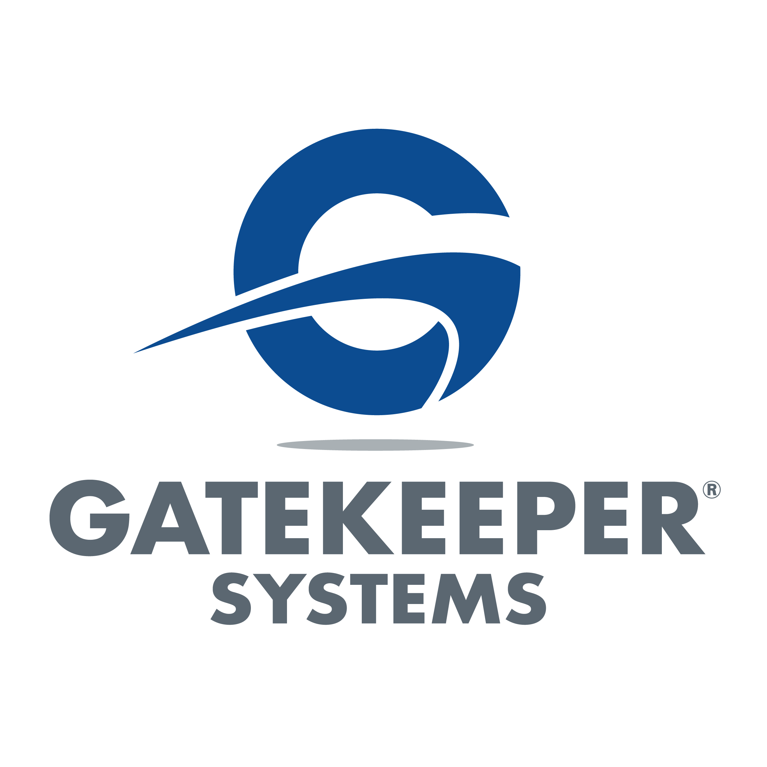


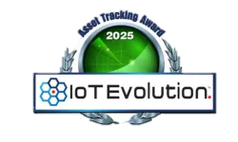


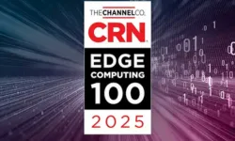


Proven Leadership Team Driving Scalable Growth
Saleel Awsare
President & Chief Executive Officer
Brent Stringham
Chief Financial Officer
Mathi Gurusamy
Chief Product & Strategy Officer
Kurt Hoff
Chief Revenue Officer
Steve Burrington
VP Global Research & Development
Dennis Gallagher
VP/General Counsel & Corporate Secretary
Sano Marsiano
VP Operations
25+ years of experience
25+ years of experience
25+ years of experience
25+ years of experience
25+ years of experience
25+ years of experience
20+ years of experience
Recognized Industry Leadership
~300 Full-Time
Employees
Fox Series
Telematic Gateways
Open-Q SOMs Series
PoE++ switches
Top 50 Edge Computing Innovators
IoT Company
CEO of the Year
NTC-500 Series Gateway

Slide 16

Strategically Positioned for Multi-Year, High-Growth at the Intelligent Edge
Mission-Critical Solutions Across Three Key Verticals:
Critical infrastructure monitoring, enterprise IT, and unmanned aerospace systems
Global Leadership Through Two Clear Growth Businesses
Edge IoT and Network Infrastructure
Global Product Development Design Wins Validate Strategy
Provides multi-year revenue visibility through drones, tier-1 carrier, out-of-band management
Differentiated Technology Platform and IP
NDAA/TAA -compliant solutions, camera/edge compute expertise, and Qualcomm ecosystem partnership
Well-Positioned for Secular Growth
In AI-driven infrastructure, aerospace modernization, and digital transformation
1

Slide 17
Appendix

Slide 18
GAAP Income Statement
Unaudited Consolidated Statements of Operations (In thousands, except per share data)

Slide 19
GAAP to Non-GAAP Reconciliation
Unaudited Reconciliation of GAAP to Non-GAAP Adjustments (in thousands, excerpt per share data & %’s)

Slide 20
Balance Sheet
Unaudited Consolidated BS (In thousands)

Slide 21
Segmented Revenue
Unaudited Net Revenues by Product Line and Region (In thousands)

Slide 22
Discussion of Non-GAAP Financial Measures
Non-GAAP net income consists of net loss excluding (i) share-based compensation and the employer portion of withholding taxes on stock grants, (ii) depreciation and amortization, (iii) interest income (expense), (iv) other income (expense), (v) income tax provision (benefit), (vi) restructuring, severance and related charges, (vii) acquisition related costs, (viii) impairment of long-lived assets, (ix) amortization of purchased intangibles, and (x) amortization of manufacturing profit in acquired inventory.
Non-GAAP net income per share is calculated by dividing non-GAAP net loss by non-GAAP weighted-average shares outstanding (diluted). For purposes of calculating non-GAAP net income per share, the calculation of GAAP weighted-average shares outstanding (diluted) is adjusted to exclude share-based compensation, which for GAAP purposes is treated as proceeds assumed to be used to repurchase shares under the GAAP treasury stock method.

