Slide 1
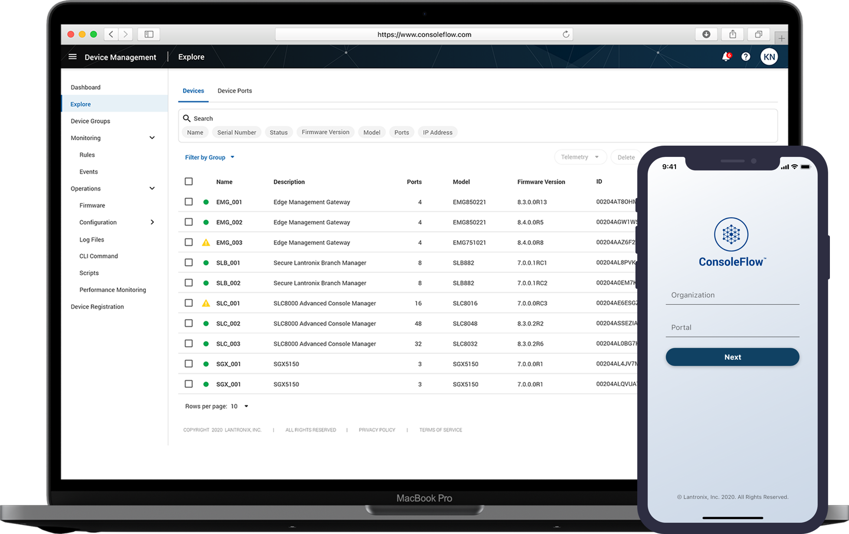
Insights from the edge.
Increase your operational efficiency and create new revenue streams with our ready-to-use software platform for your IoT and REM assets.

Slide 2
Agenda
Our Approach
ConsoleFlow Platform Overview
Roadmap

Slide 3
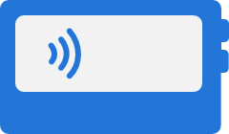
IoT as a Concept
5 Key Concepts that lead us to an IoT solution.
COLLECT
Ingest environmental data from an end point.
CONNECT
Access or transmit data to achieve a purpose.
COMPUTE
Normalize the data from edge to cloud and use it for simple events or complex machine learning.
COMPREHEND
Visualize and Analyze collected data from different forms to comprehend business outcomes.
CONTROL
Remote visibility and control over the end-to-end operational details of an IoT solution.
Control
Comprehend
Collect
Compute
Connect
Notes:
Defining IoT
5 key concepts that lead us to a solution.
Shows a customer we deliver.
Comprehend – Different forms - Log Files, Event Triggers, Script Results, …

Slide 4
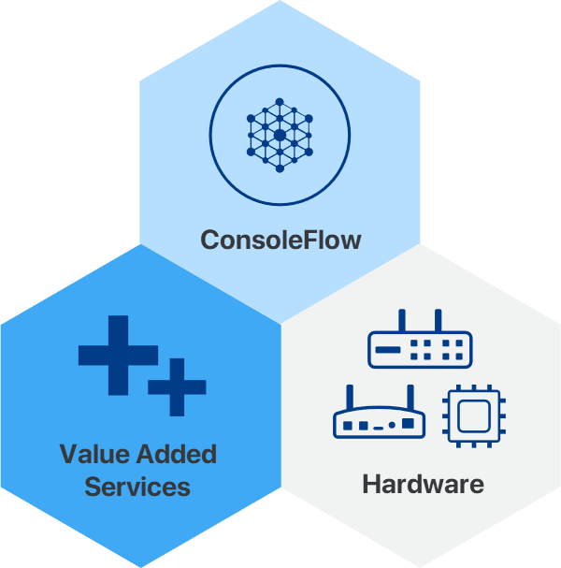
Interlocking pieces defining an IoT Solution.
ConsoleFlow
Visibility and Control in an easy single pane of glass web app. Knowing what is happening across your deployment and having the tools to respond.
Value Added Services
Go beyond just visibility and control by easily selecting the service you need. Provision cellular and VPN services for pick and go worldwide connectivity. Engineering services for assistance with custom software and hardware projects.
Hardware
No solution is complete without matching hardware to achieve your specific requirements and real-world applicabiity.
Our Approach
Notes:
Defining an IoT Solution
3 Pieces: Single pane of glass to manage services and features to meet software and services requirements.
Hardware

Slide 5
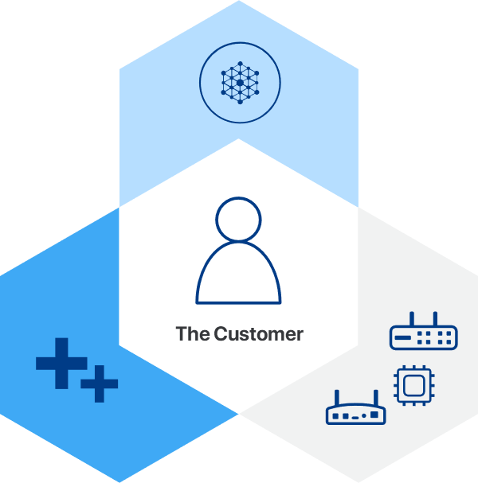
An IoT Solution Applied
The customer success is everything.
Our experience with thousands of global blue-chip customers across many vertical markets, enables us to tailor the right technical solution, delivering to the customer’s business requirements, generating successful outcomes.
Notes:
Contextual relevance of the customer.
Understanding the customer
Customer Intimacy

Slide 6
ConsoleFlow Overview

Slide 7
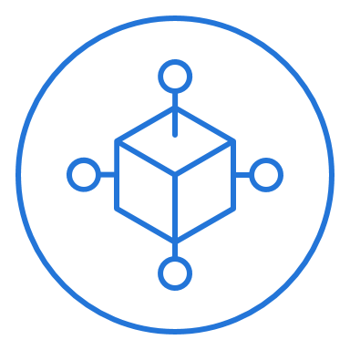
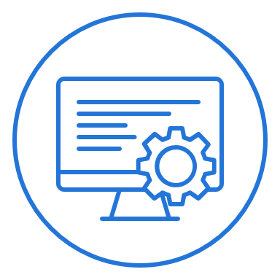
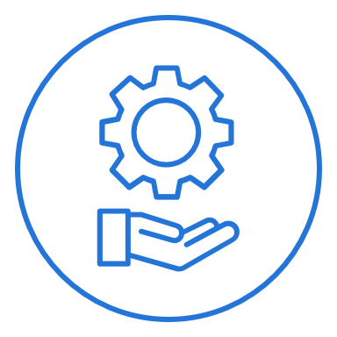
Get to market quickly and increase your operational efficiency with our secure ready-to-use IoT platform.
OPERATIONS
Centrally manage your devices from anywhere
in the world, at any time.
AUTOMATION
Save time and costs with True Zero Touch automation for device provisioning.
CONTROL
Visibility and Control in a single pane of glass, knowing what is happening across your deployments and having the tools to respond.

Slide 8
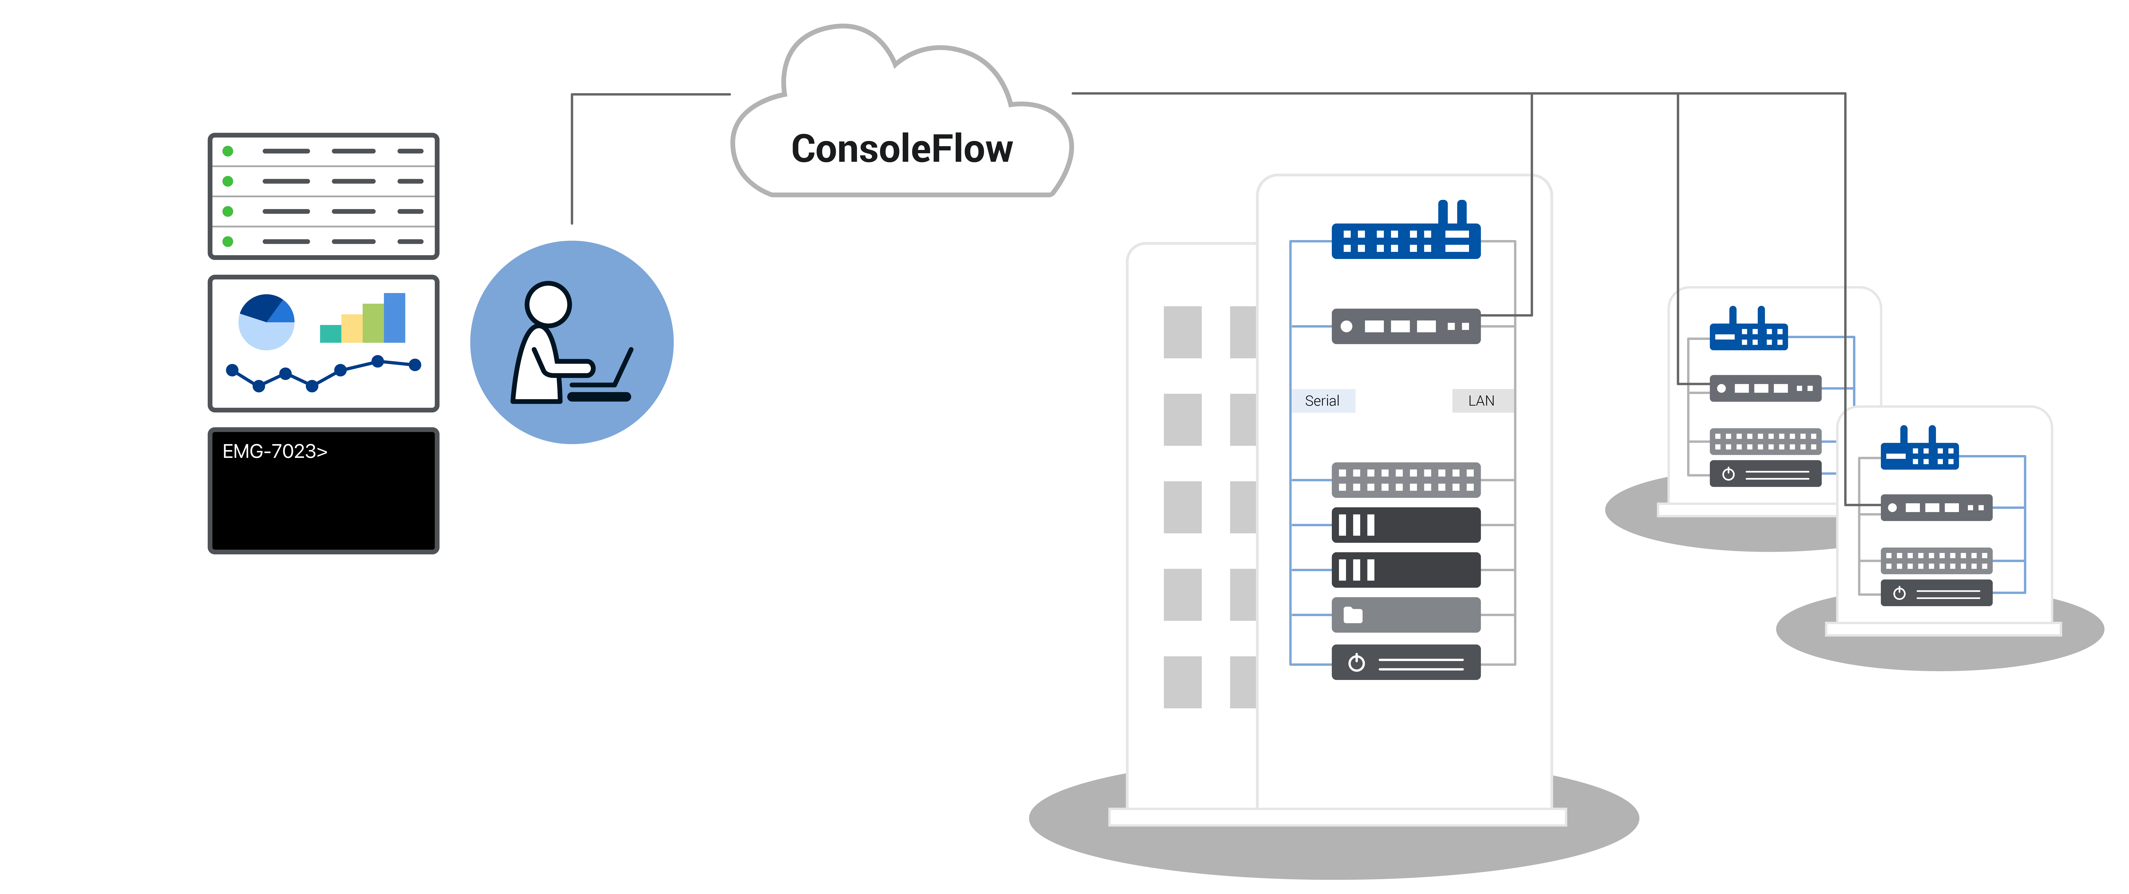
ConsoleFlow Management Platform
A single pane of glass to view and control your devices.
OPERATIONS
Explorer directory view of all devices and ports status.
Search and create device groups for OTA operations.
Secure Remote Access to edge connected devices.
Remote GUI-based device configuration.
Log File Retrieval and Configuration backup/restore.
AUTOMATION
True Zero Touch device import and provisioning.
Device telemetry data monitoring and notifications.
Run Python scripts for automated NetOps management.
CONTROL
Administer and manage portals, tenants, and users.

Slide 9
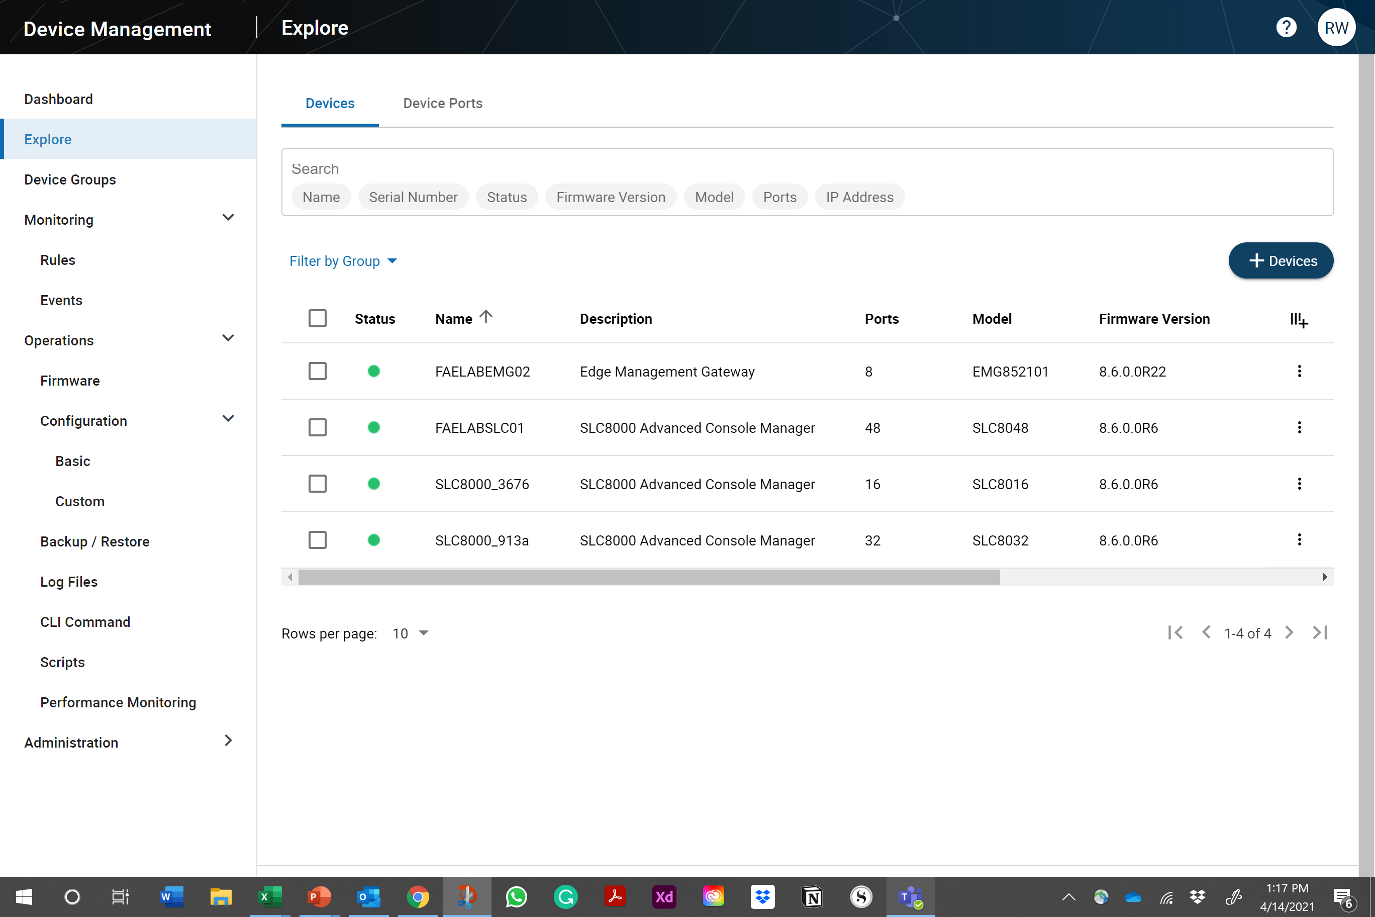
Operations
View your globally distributed assets through a single pane-of-glass, anywhere, and any time.
ASSET AGGREGATION
Explore and quickly find the specific assets you need across your entire inventory of IT and IoT equipment.
ASSET DATA AGGREGATION
View the real-time status or chart the asset telemetry data.
ASSET DETAIL VIEW
Select a tab to easily view the
specific details needed.

Slide 10
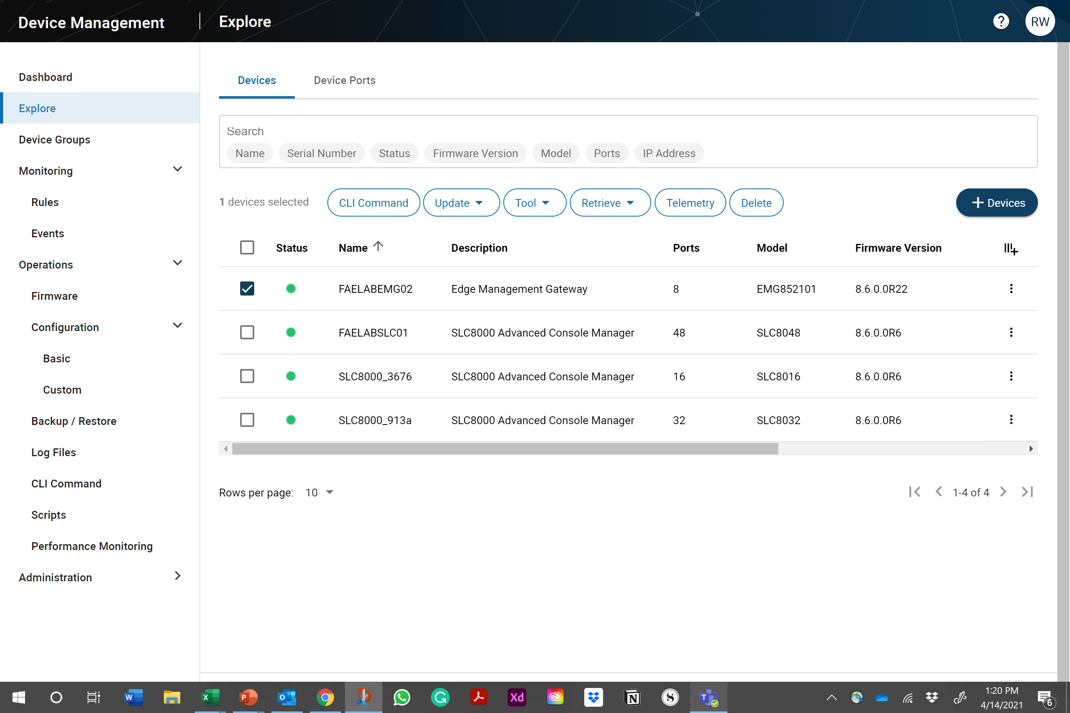
Operations
Securely access your assets remotely to troubleshoot issues in real-time.
REMOTE ACCESS
Operators can securely access the Lantronix console and the connected network assets.
DIAGNOSTICS
Reboot or restart a remote device.
LOCAL DEVICE CONFIGURATION
Save or restore the local device configuration to resolve erroneous changes.

Slide 11
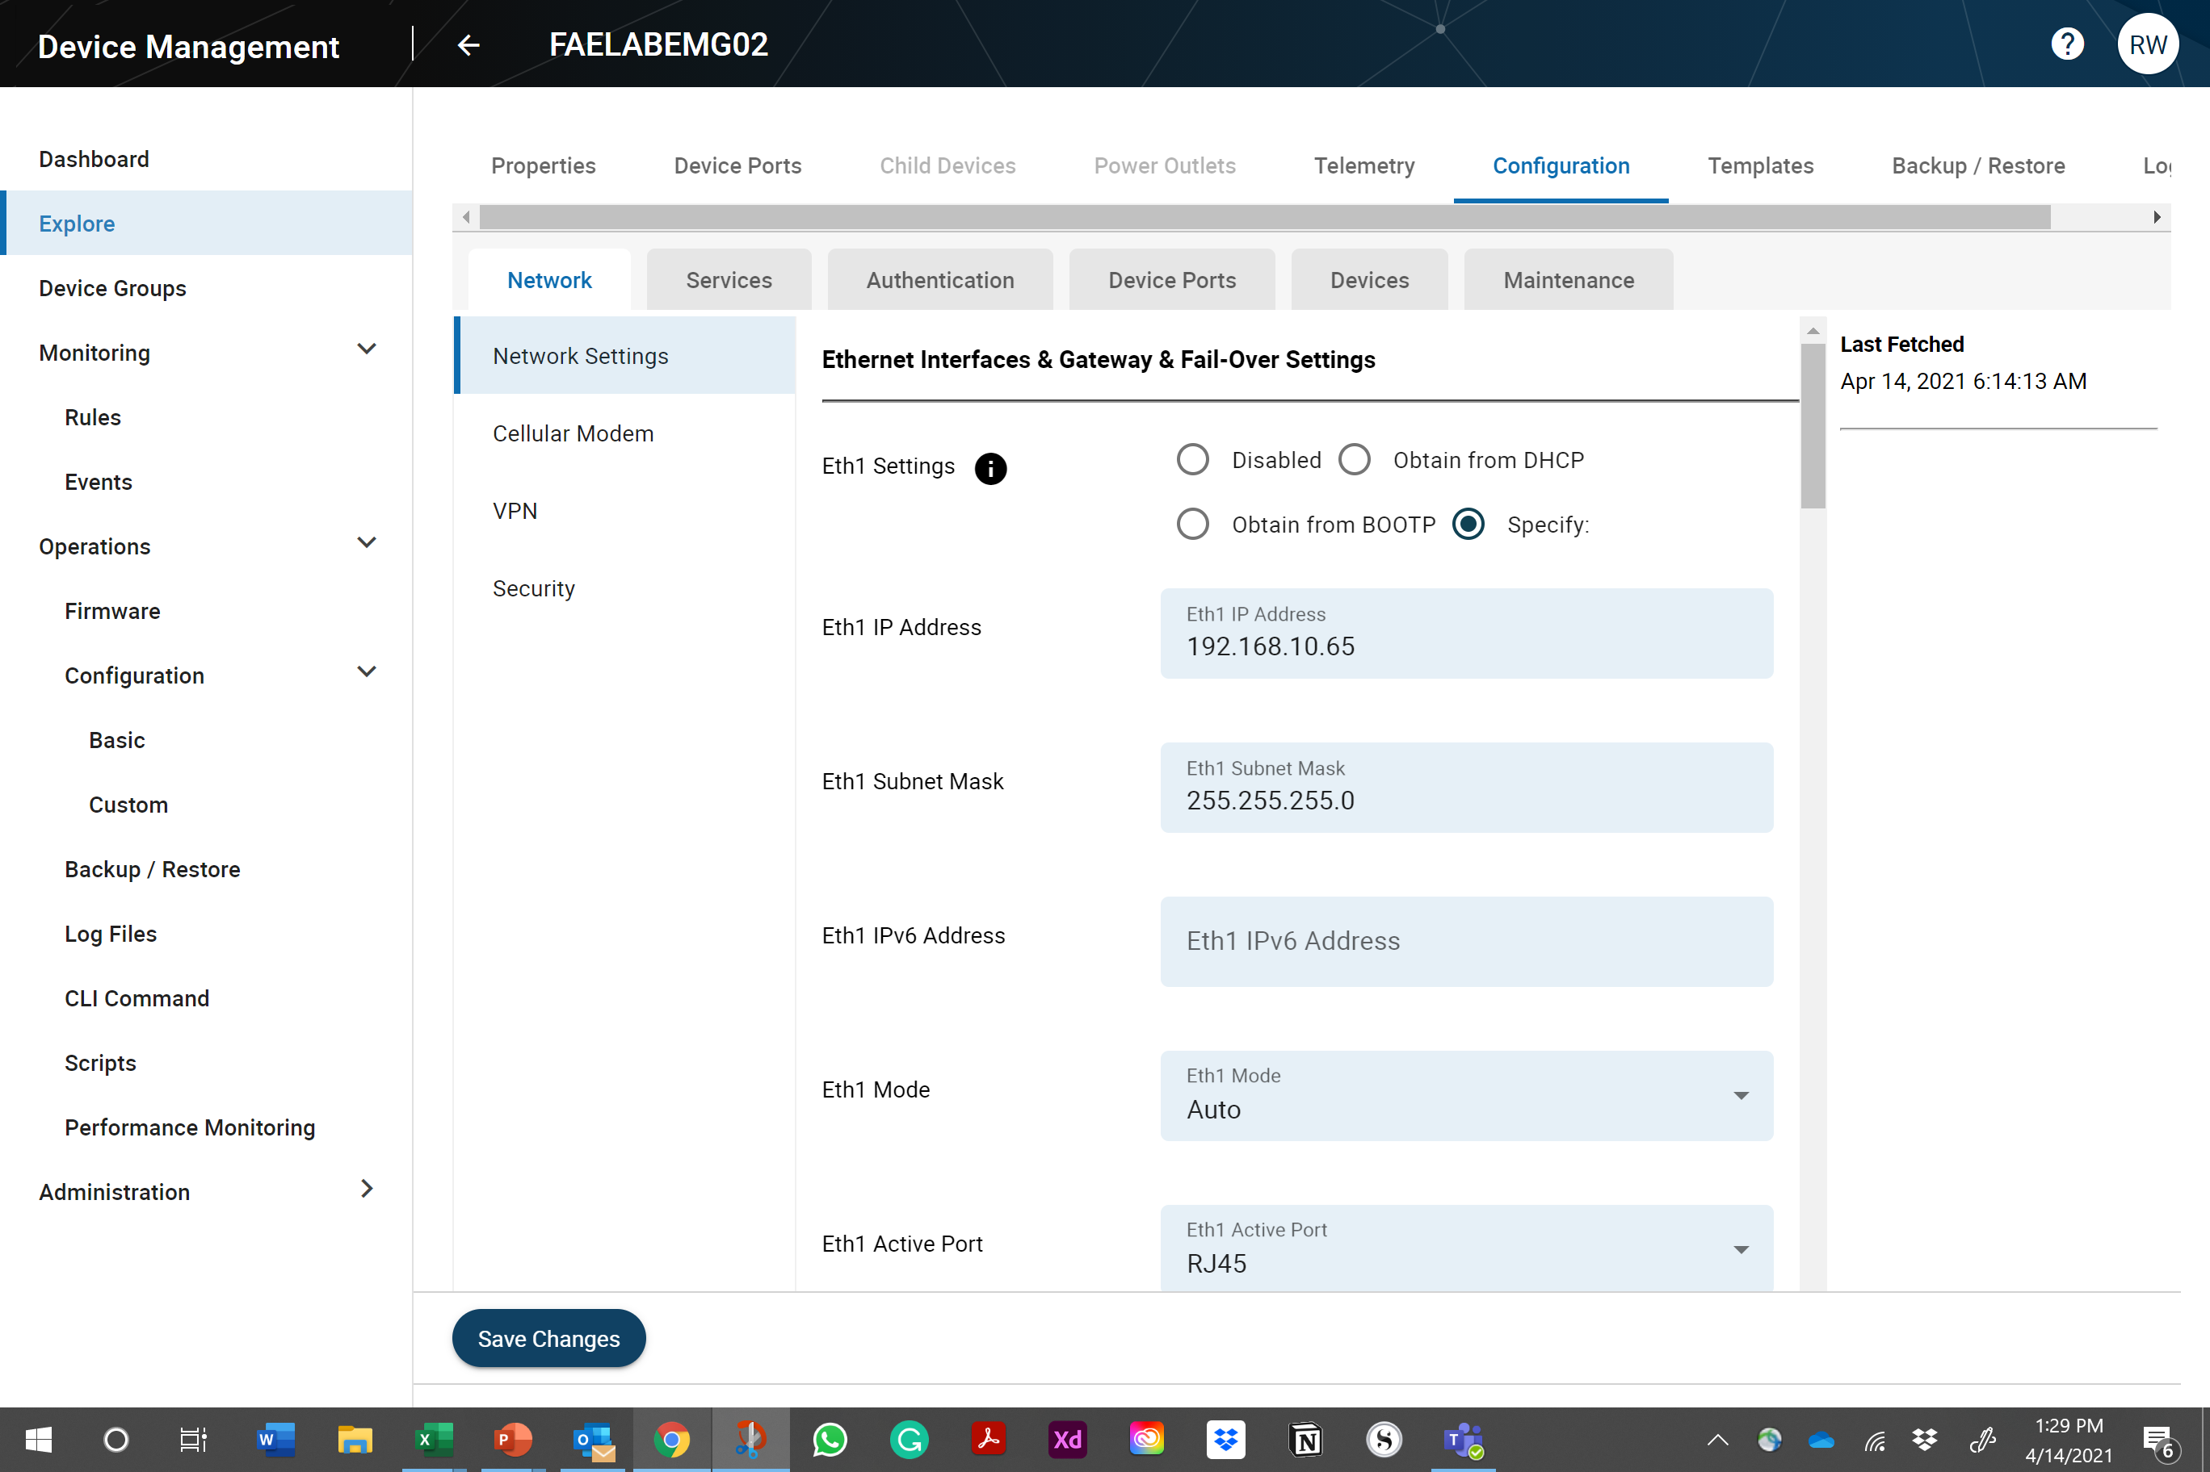
Operations
Update your configuration through the GUI, and
create a template to replicate across a set of devices.
REMOTE ASSET MAINTENANCE
Keep firmware and configuration updated
with the latest security patches.
GUI CONFIGURATION
Select a device and make changes directly using an easy-to-use graphical user interface.
TEMPLATES
Create a template from the GUI selections and update a select number of devices.

Slide 12
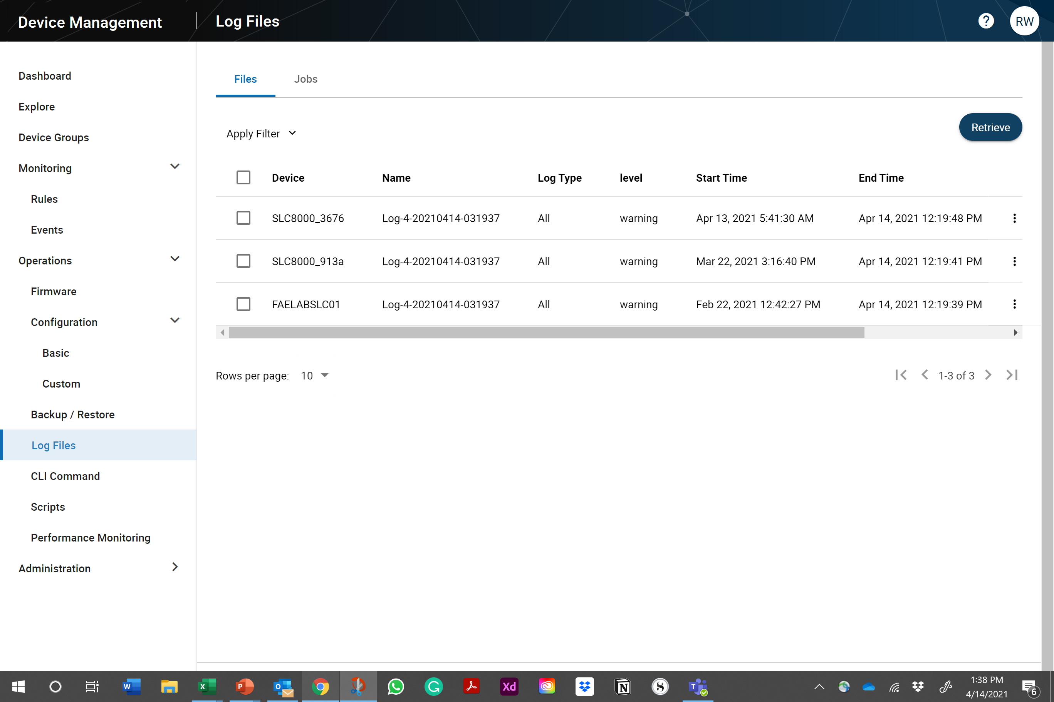
Operations
Perform remote maintenance, send CLI commands, upload log files, and backup and restore.
REMOTE ASSET MAINTENANCE
Keep firmware and configuration updated with the latest security patches and operational optimization.
LOG FILES
Retrieve and save the latest log files. Download the logs files to view the details.
TROUBLESHOOT DEVICE
Remotely restart, reboot, or save and restore local asset configuration.

Slide 13
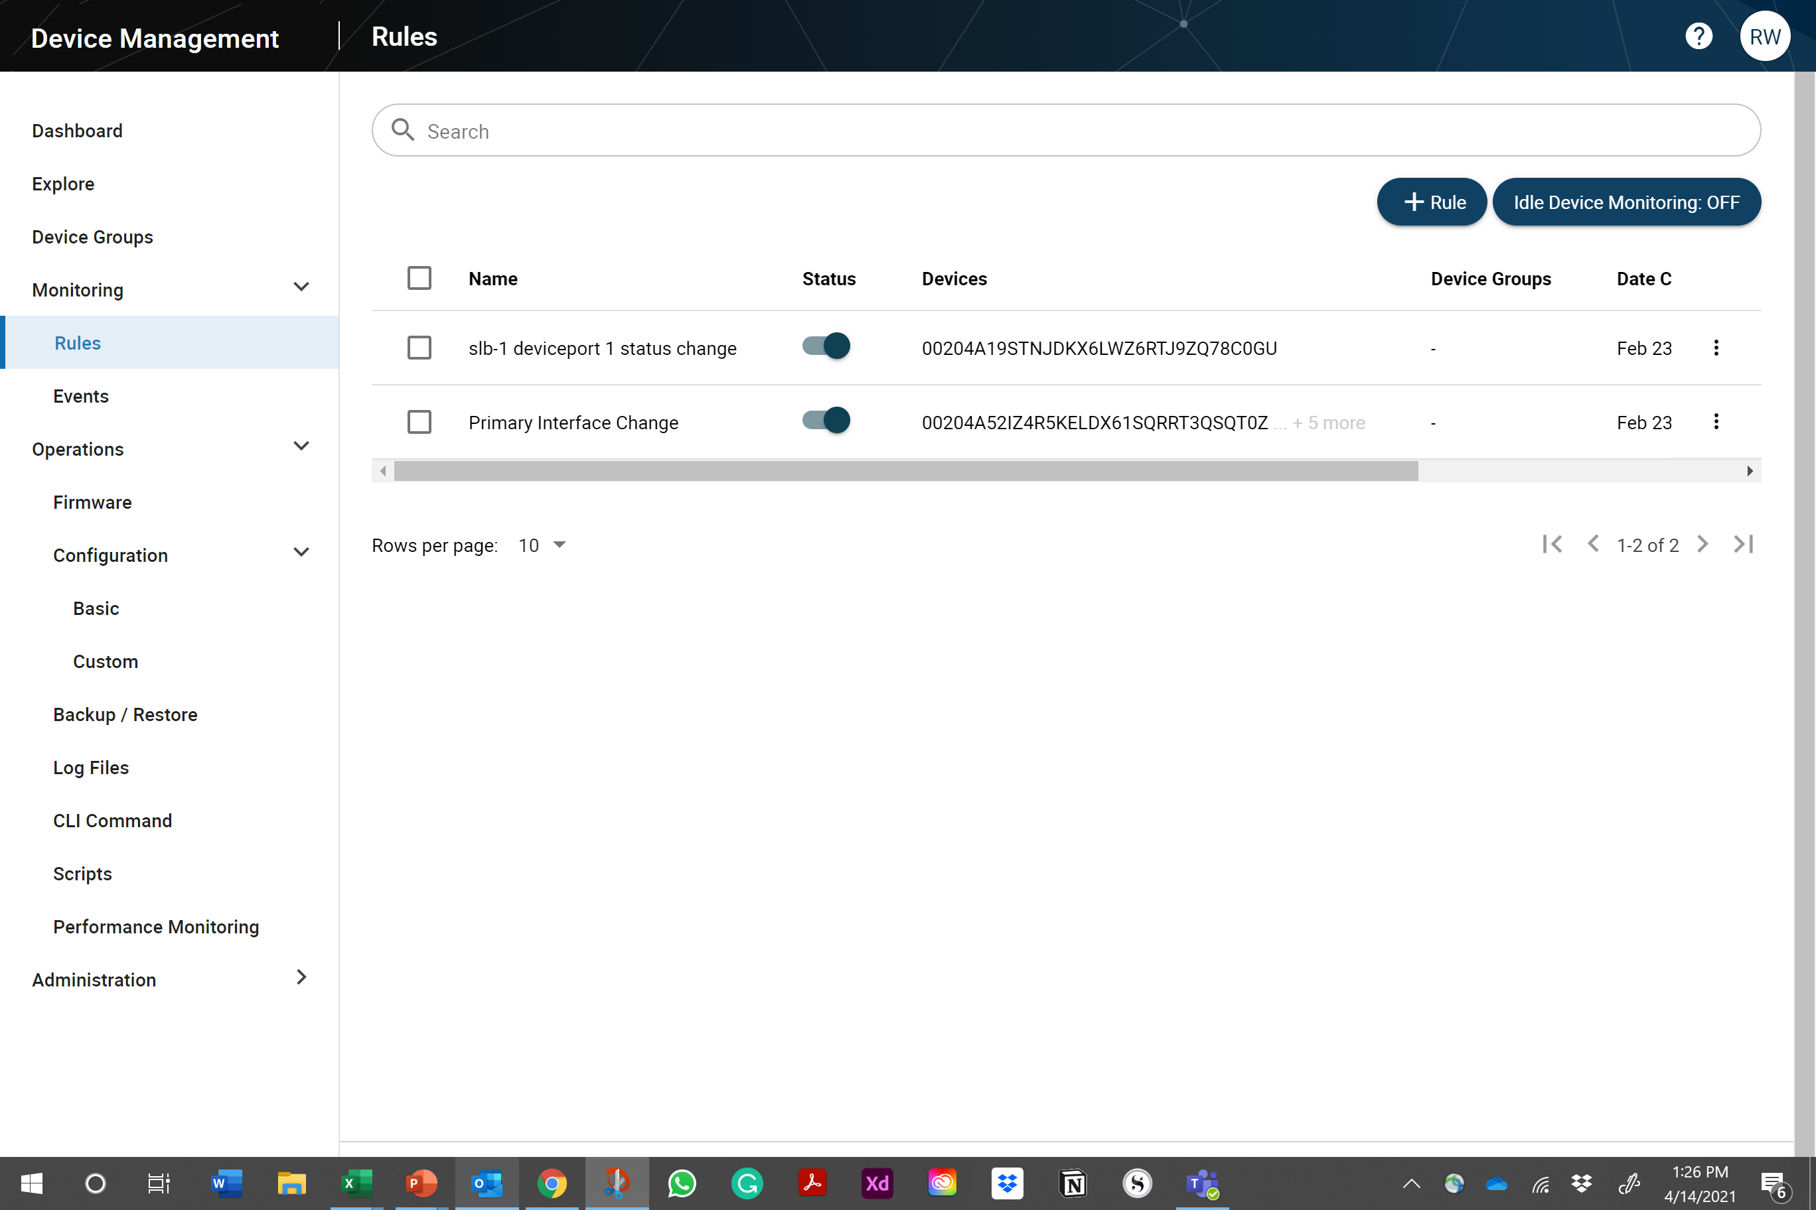
Automation
Network operators can remediate issues in real-time,
Reducing costly onsite visits to remote office locations.
AUTOMATION
Network Operators can create rules for critical event triggers on specific asset status and health data.
IT network operators are notified
when events are triggered, through
email, SMS, or push notifications.
Event results are listed and show the asset, event trigger type, before and after values and the timestamp.
Notes:
We provide Automation and Remote Access

Slide 14
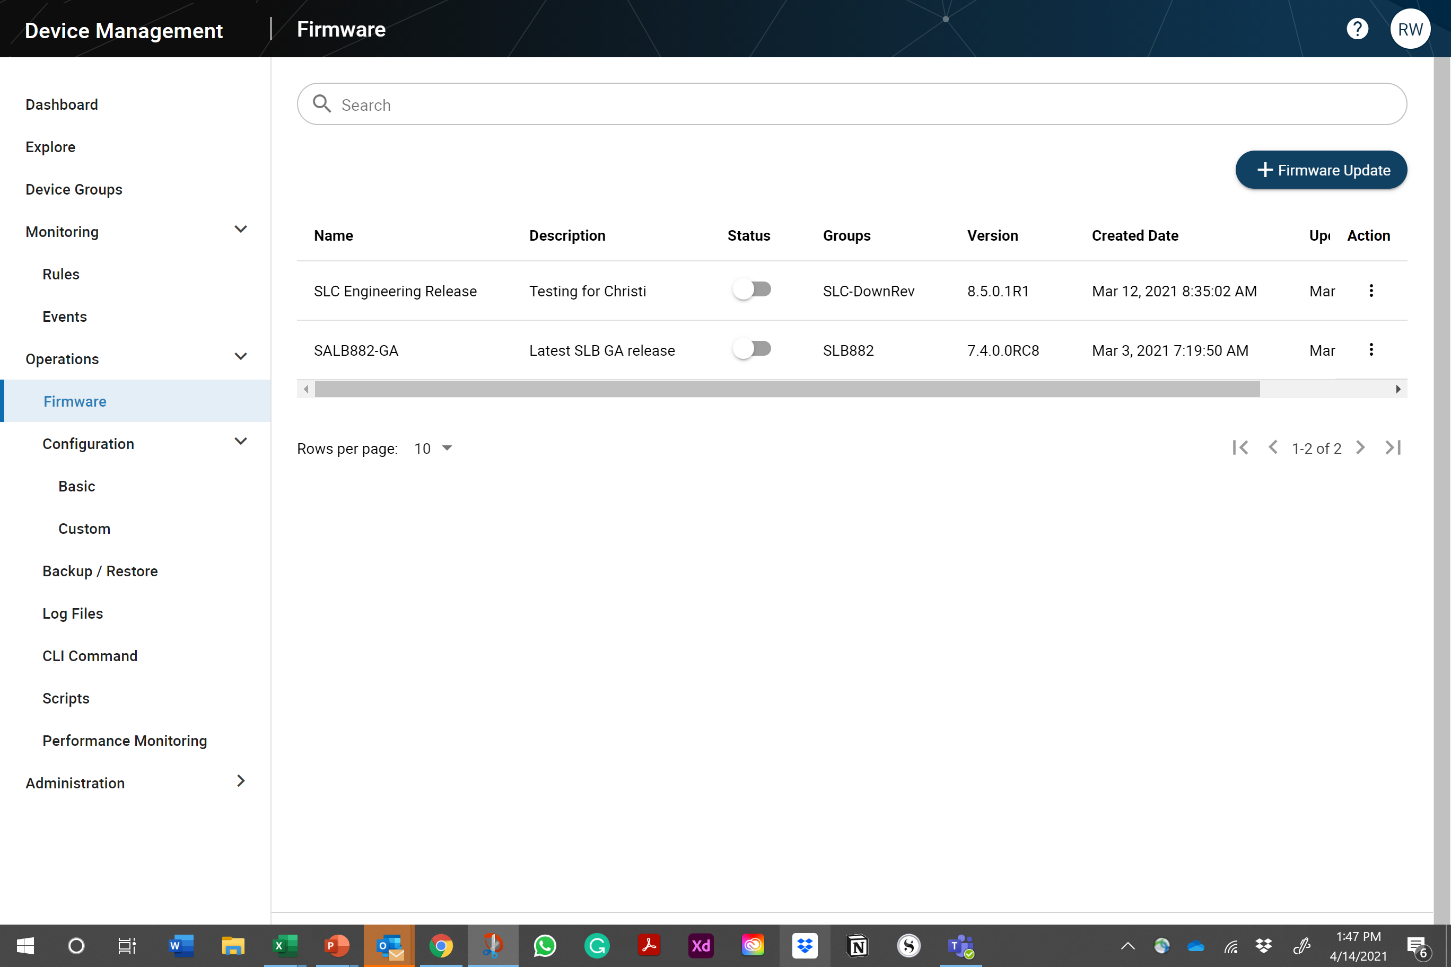
Automation
True Zero Touch automation reduces human intervention errors and needed onsite visits to provision remote devices.
UPDATE OPERATION
Operator creates a firmware or configuration update.
Deployed assets automatically check for updates when powered on.
If an update is available, it will automatically download the file.
On asset restart, the new firmware or configuration updated will take effect.

Slide 15
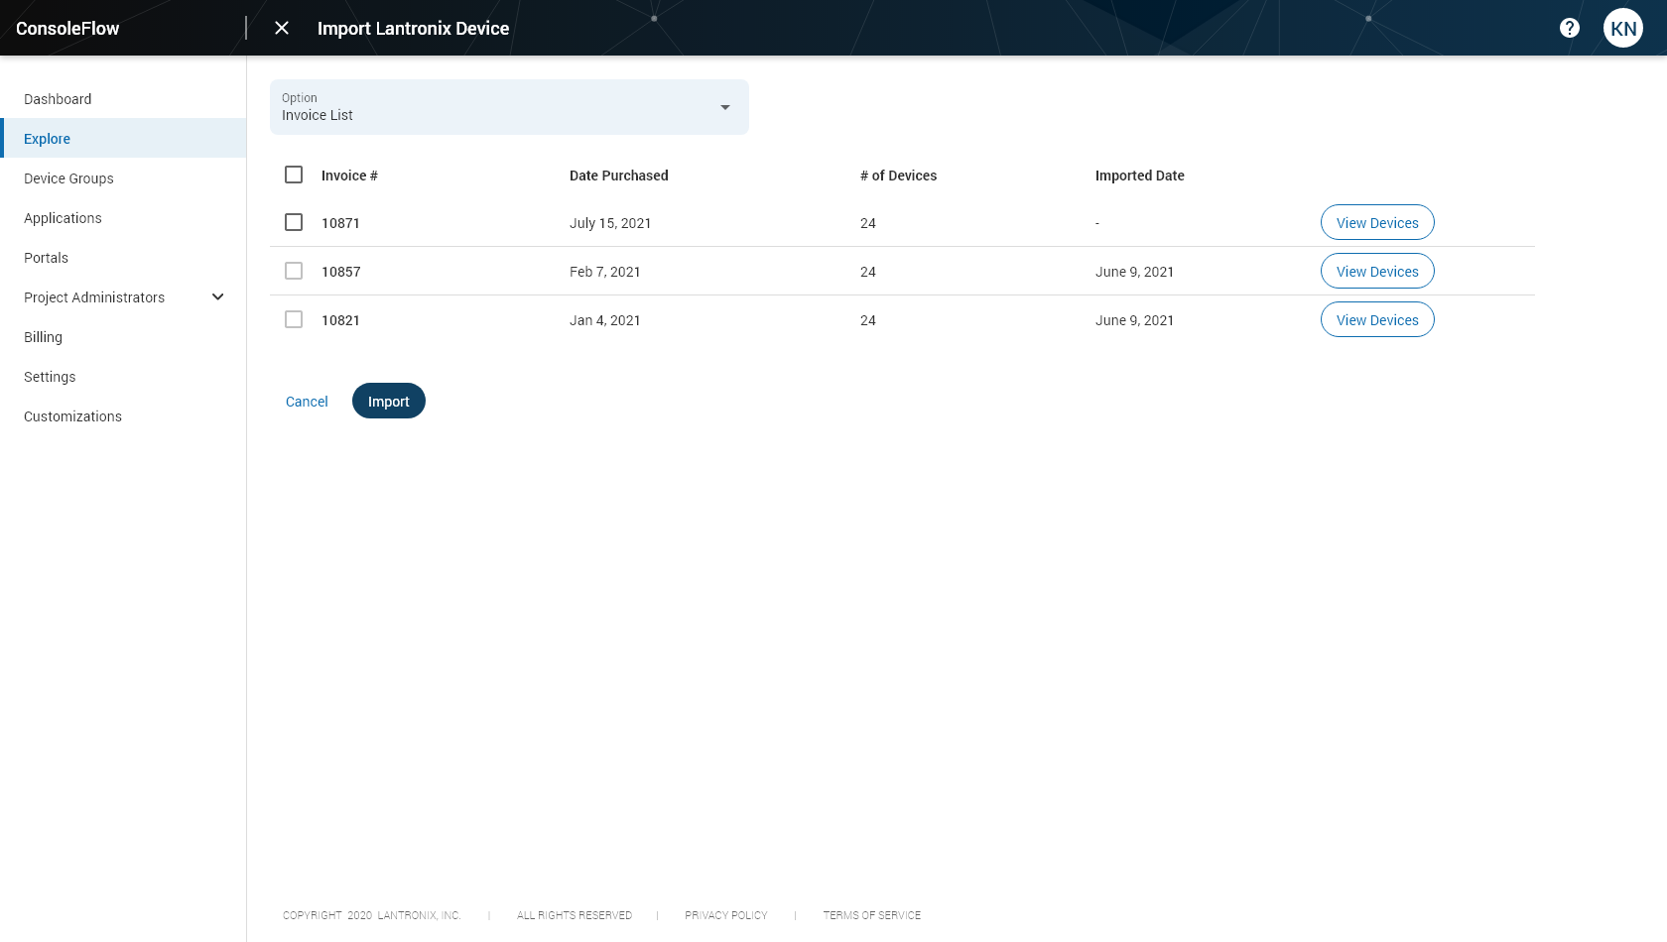
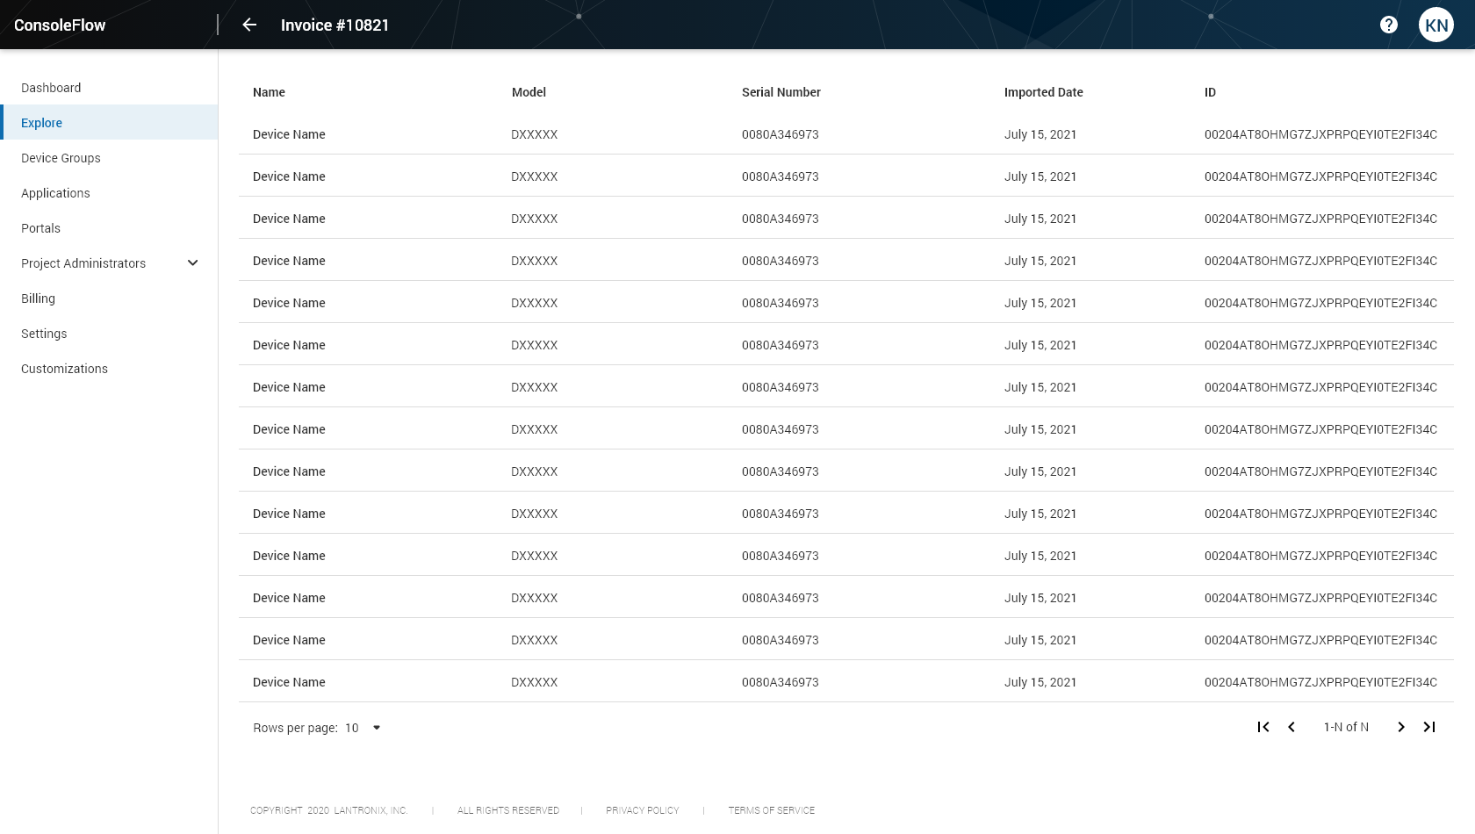
Automation
True Zero Touch automation imports known devices to a customer account when purchased.
ONBOARDING OPERATION
Purchased devices are automatically imported into a ConsoleFlow customer account.
Administrators can view the invoice number and the associated devices added to their account.
Devices can then be assigned to the end customer account.

Slide 16
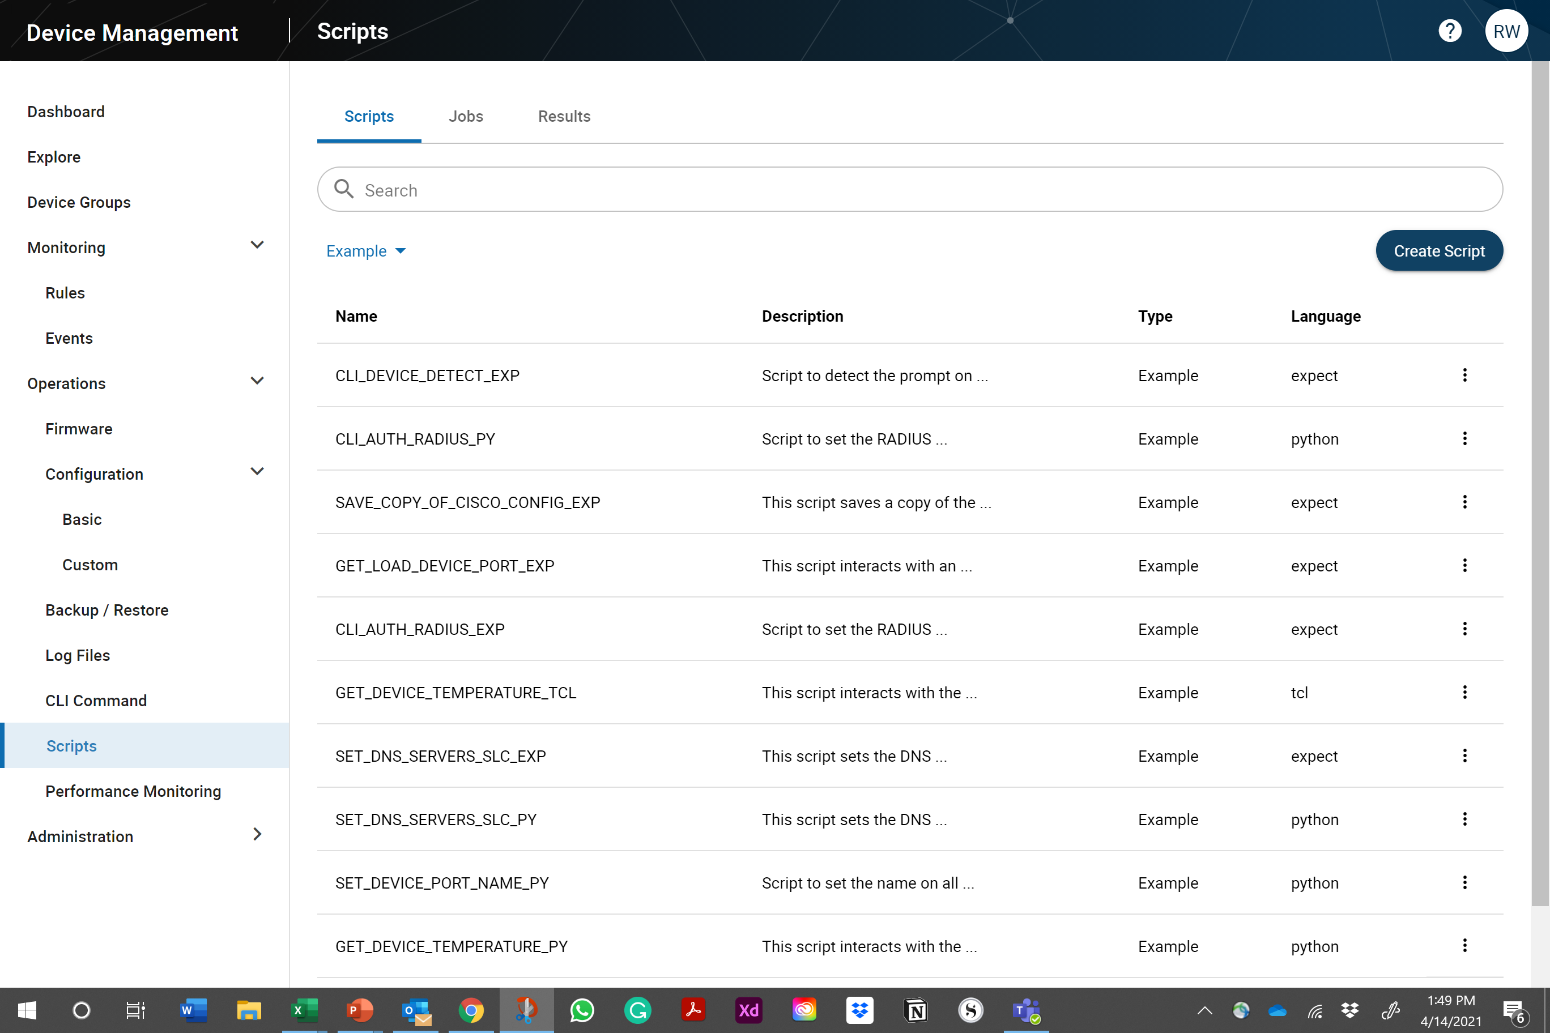
Automation
Software-defined operations for network resilience.
SCRIPTING
Create and schedule script jobs that monitor, maintain, and capture status data on your network infrastructure assets.
Create Expect, TCL and Python scripts and view the result data.
PERFORMANCE MONITORING
Monitor your network with integrated Cisco IP-SLA probes compatible network performance monitoring.

Slide 17
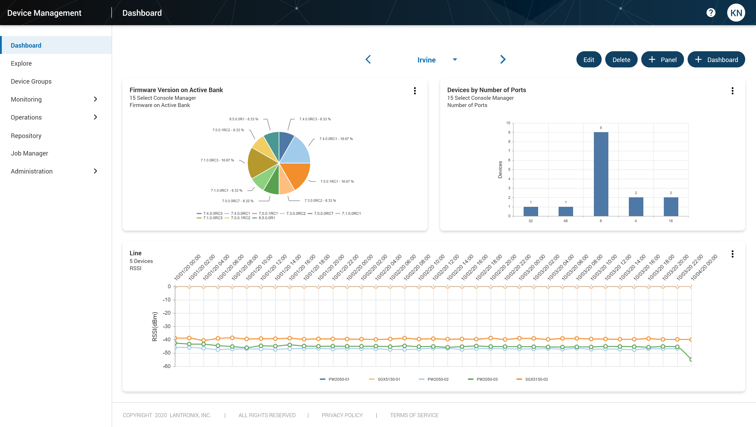
Control
Accessing status data and log information to analyze trends to improve resiliency and efficiency.
VISUALIZATION
Create custom dashboards per use.
Create charts for each dashboard based upon the asset telemetry data.
Create real-time charts or time series data historical charts.
ANALYTICS
Run analysis on time-series data to identify trends and anomalies.
Publish charts to the dashboard.

Slide 18
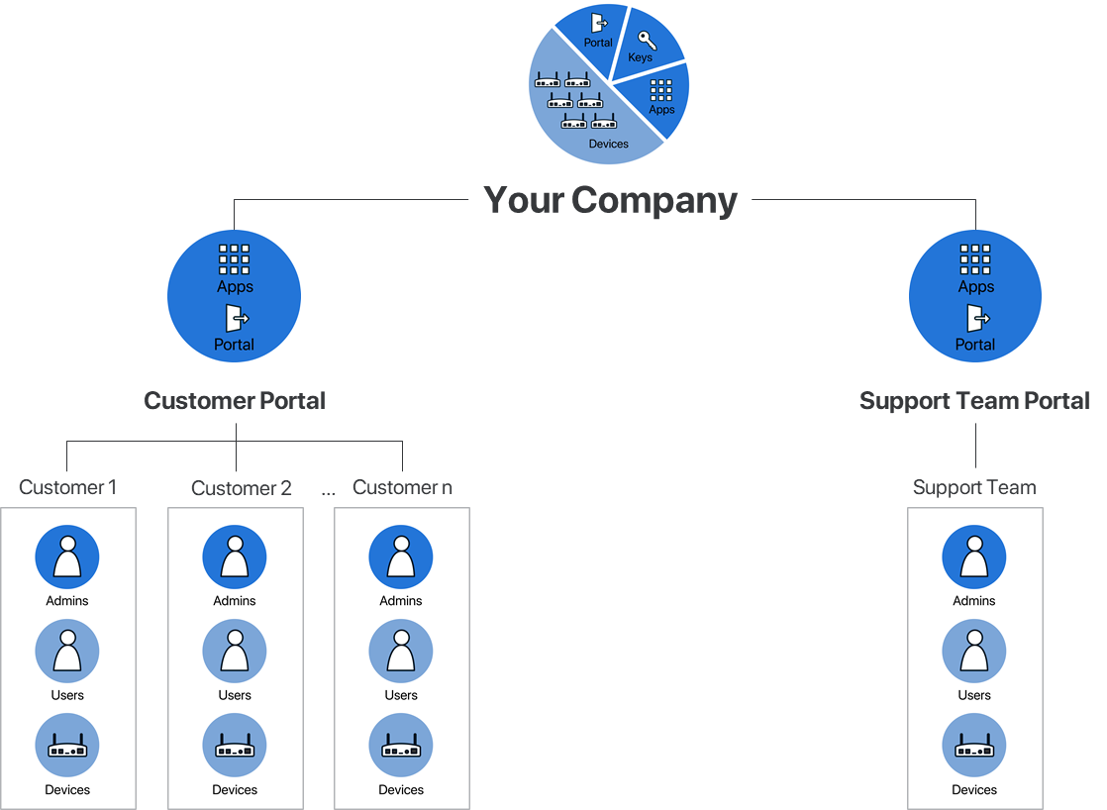
Control
Create new revenue streams by delivering managed services to your end customers.
MULTIPLE PORTALS
Create portals that are aligned with your use cases and business objectives.
A portal can be created for each customer for them to manage their own devices.
MULTIPLE TENANTS
A single portal can support multiple tenants. All tenants are kept separate and secure.
A portal can also be created for each customer.

Slide 19
ConsoleFlow
A healthcare customer use case example.

Slide 20
Why Customers Choose Lantronix
Your success is our top priority.
01
We elegantly combine software as a service (SaaS), connectivity services, and intelligent hardware to produce turnkey solutions
02
Our secure turnkey solutions empower customer success by streamlining deployment, accelerating time to market, and driving operational efficiency
03
Expertise and engineering services let us offer off the shelf and custom developed products and solutions which dramatically simplify effort, architecture, deployment and operations of IoT and REM projects
Notes:
Jon, major re-write more inline with our strategy of complete solutions and the IoT Stack

Slide 21
Thank You

