Slide 1

Connectivity Services
Secure global internet for everything.
Simplify connecting your IoT fleet and remote edge locations, on every network, using a single SIM.

Slide 2
Agenda
A Turnkey IoT Solutions Company
Connectivity Services Overview
Global Connectivity
Carrier Connectivity
Secure VPN
Cellular Management Platform
Support Services

Slide 3





IoT as a Concept
COLLECT
Ingest environmental data from an end point.
CONNECT
Access or transmit data to achieve a purpose.
COMPUTE
Normalize the data from edge to cloud and use it
for simple events or complex machine learning.
COMPREHEND
Visualize and Analyze collected data from
different forms to comprehend business outcomes.
CONTROL
Remote visibility and control over the end-to-end operational details of an IoT solution.
Control
Comprehend
Collect
Compute
Connect
Notes:
Defining IoT
5 key concepts that lead us to a solution.
Shows a customer we deliver.
Comprehend – Different forms - Log Files, Event Triggers, Script Results, …

Slide 4
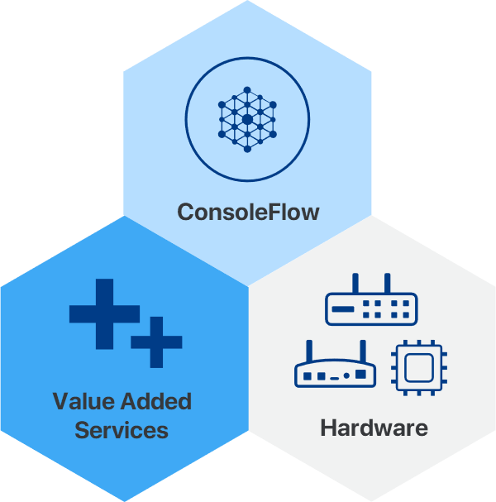
Interlocking pieces defining an IoT Solution.
ConsoleFlow
Visibility and Control in an easy single pane of glass web app. Knowing what is happening across your deployment and having the tools to respond.
Value Added Services
Go beyond just visibility and control by easily selecting the service you need. Provision cellular and VPN services for pick and go worldwide connectivity. Request engineering services for assistance with custom software and haredware projects.
Hardware
No solution is complete without matching hardware to achieve your specific requirements and real-world applicabiity.
Our Approach
Notes:
Defining an IoT Solution
3 Pieces: Single pane of glass to manage services and features to meet software and services requirements.
Harware

Slide 5
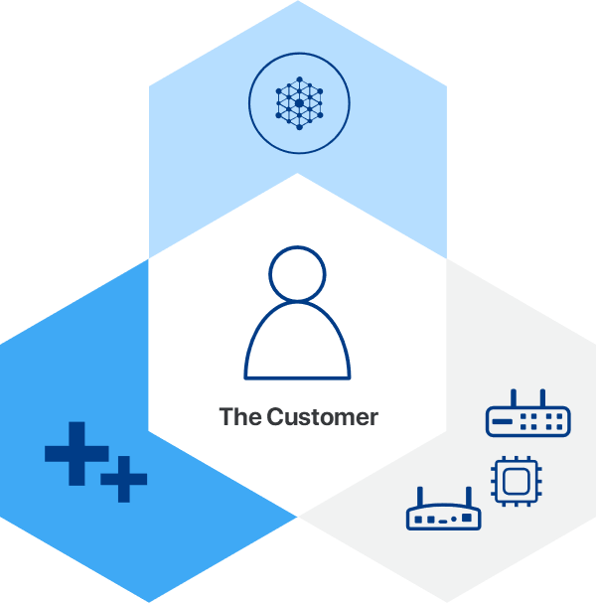
An IoT Solution Applied
The customer success is everything.
Our experience with thousands of global blue-chip customers across many vertical markets, enables us to tailor the right technical solution, delivering to the customer’s business requirements, generating successful outcomes.
Notes:
Contextual relevance of the customer.
Understanding the customer
Customer Intimacy

Slide 6


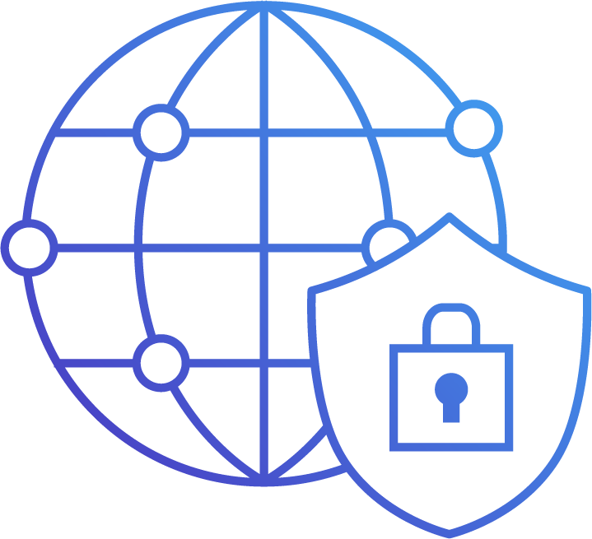



Connectivity Services Options
Multi-network redundancy for
your mission-critical apps.
The best North American
coverage and performance.
Secure IoT endpoint
connections and data.
Select from Global or Carrier Connectivity and VPN security
options that can be tailored to your IoT fleet or remote
environment connectivity requirements.
Notes:
data641003

Slide 7

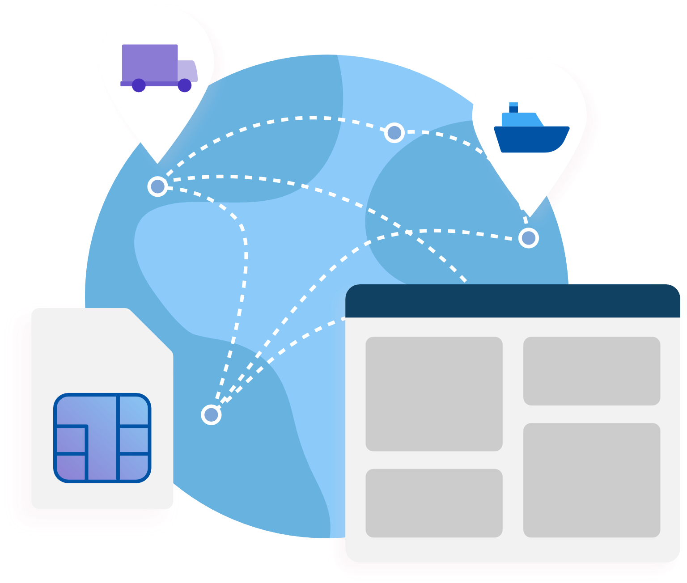
Connectivity Management
Our cellular platform makes it easy to activate, monitor, and manage your assets from anywhere, at any time.
SIMPLICITY
The easy-to-use cellular platform enables you to focus on operational efficiency and increasing your ROI.
ACTIVATION
Select a plan and activate SIM connectivity for your IoT assets.
MONITORING
Monitor asset connectivity status,
set important event triggers, and
receive alerts and notifications.
MANAGEMENT
Analyze your SIM usage data
over time to gain key insights.

Slide 8


Global Connectivity
One global SIM automatically switches between networks, providing you the best performance.
ONE GLOBAL NETWORK
One global SIM on one Access Point Name (APN)
Roam globally for one flat rate across regions and borders
“Best signal” technology, ideal for mission critical applications
No steering to preferred networks
Swaps network automatically if the signal is lost
Global Network
Global SIM
One global data SIM accesses over 600 network partners in over 185 countries worldwide.

Slide 9
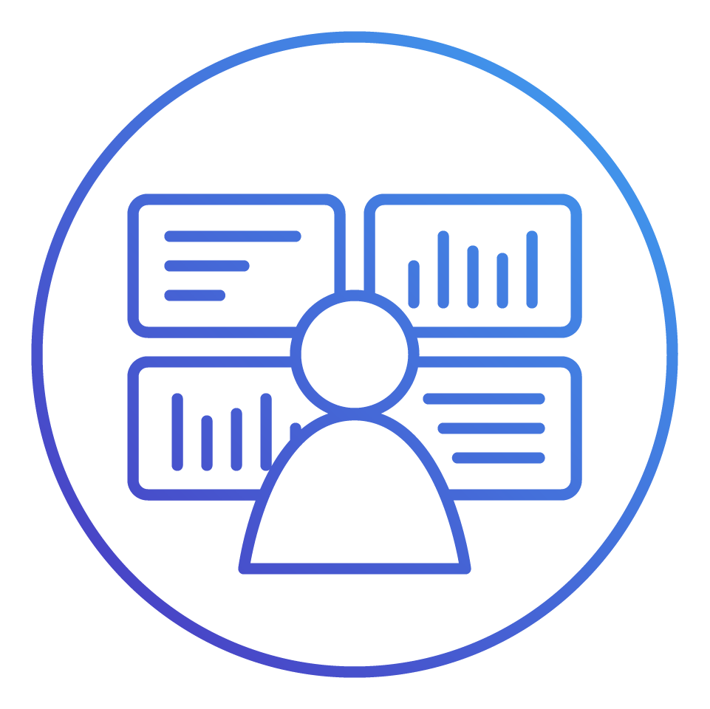

Global Connectivity
A highly resilient global network and operations center delivers maximum uptime for your mission-critical apps.
RESILIENCE
Highly resilient and redundant Multi-IMSI independent architecture.
MANAGEMENT PLATFORM
Monitor status and usage in
real-time and receive
event notifications.
OPERATIONS CENTER
Preventative and proactive measures to maximize uptime and minimize disruptions.
Network
Operation Center
Global
Network
Global
SIM
Centralized
Management
The intelligent application automatically switches IMSI
if an issue is detected on the core network

Slide 10
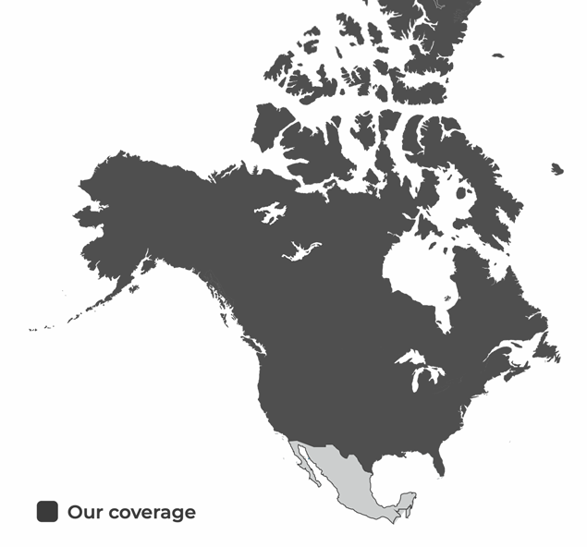

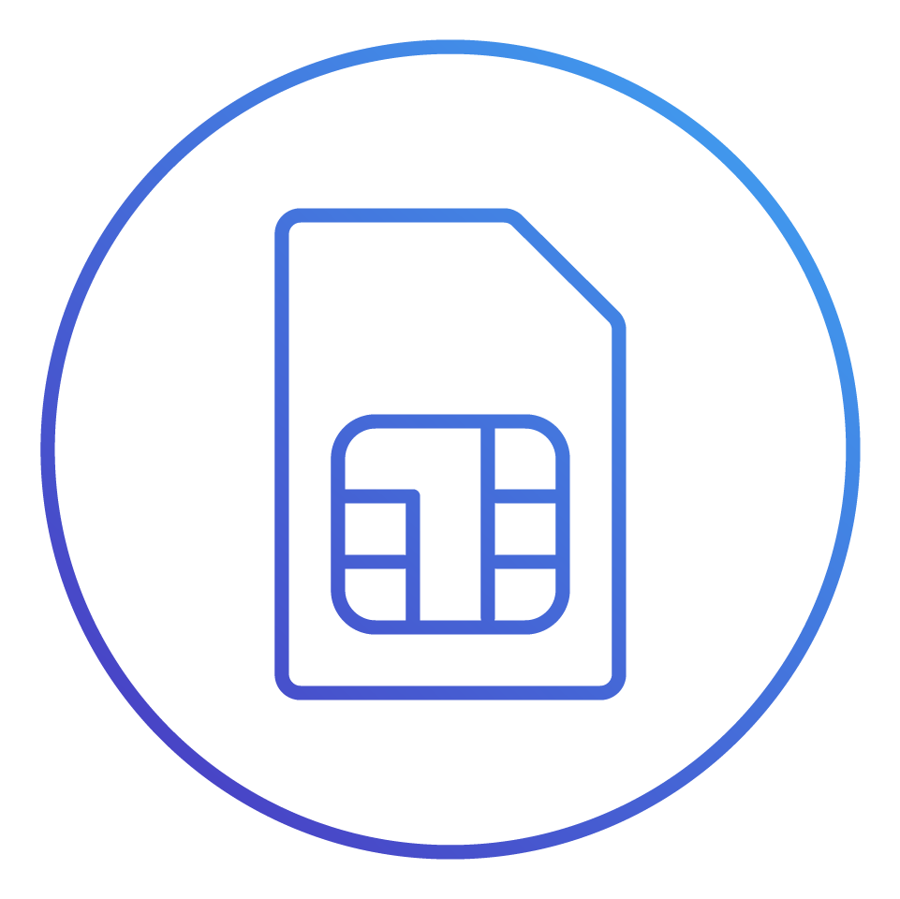




Carrier Connectivity
The best North American coverage and
performance for your IoT connectivity solution.
MAJOR CARRIERS
No need to worry about carrier contracts and agreements.
Select from the four
tier-one carrier networks.
We offer the best possible rate plans in your area.
Our coverage also Includes Rogers in Canada.
AT&T provides for roaming in Mexico.
Carrier
Network
Carrier
SIM

Slide 11
Carrier Connectivity
A highly resilient network and operations center delivers maximum uptime for your mission-critical apps.
RESILIENCE
Highly resilient North American carrier networks.
MANAGEMENT PLATFORM
Monitor status and usage in
real-time and receive key event notifications.
OPERATIONS CENTER
Preventative and proactive measures to maximize uptime and minimize disruptions.
Network
Operation Center
Carrier
Network
Carrier
SIM
Centralized
Management

Slide 12
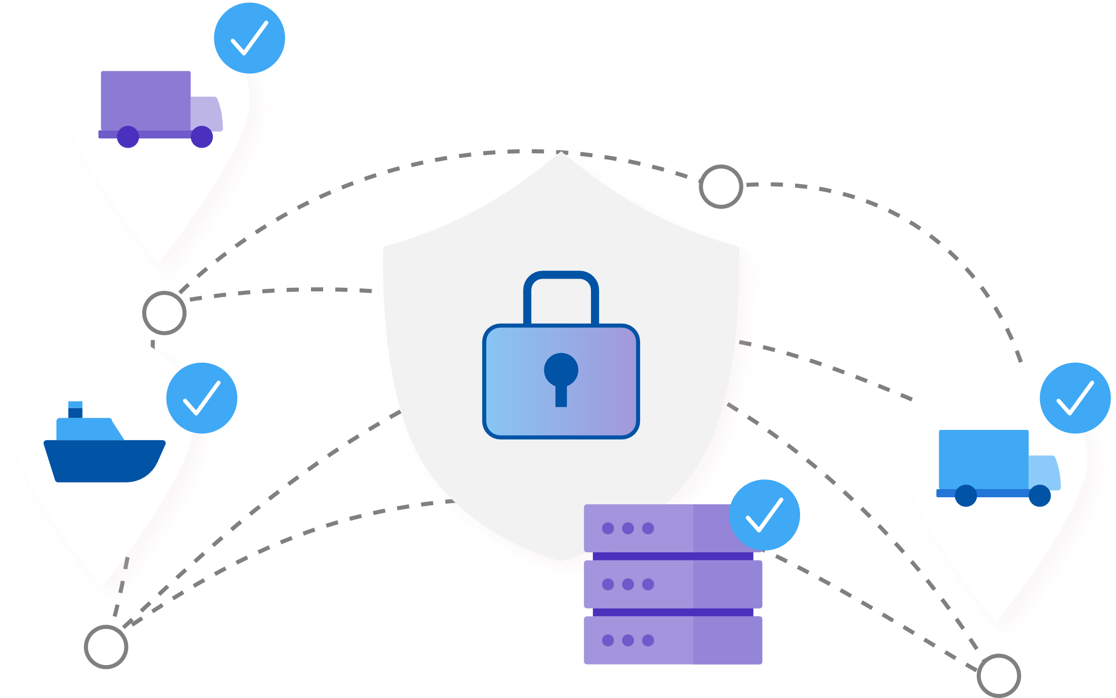
Secure VPN Connectivity
Ensuring your remote connections and data are secure.
CLIENT APP
The client app uses SSL and IPsec VPN to provide secure, reliable access to end points from virtually any internet-connected remote location.
SITE-TO-SITE
A secure IPsec tunnel is provided from the carrier network to your data center.

Slide 13
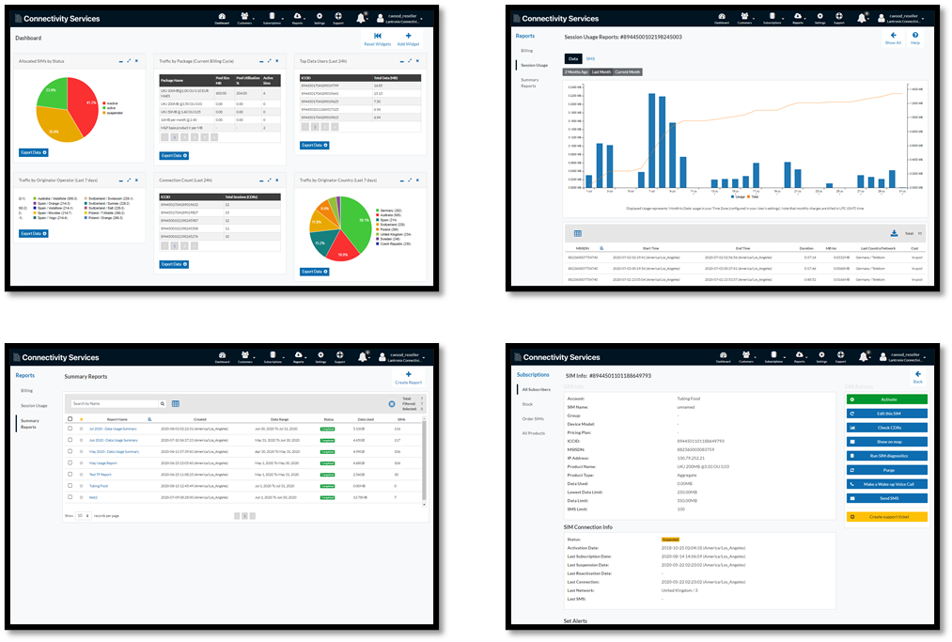
The Cloud-Based Management Platform
The easy-to-use platform provides the features you need to manage connectivity and optimize efficiency.
DASHBOARD
SIM Usage and Status Info
MONITORING
Set usage event triggers
CONTROL
Activate and manage SIMs
DIAGNOSTICS
Detailed SIM use information
ANALYTICS
In-depth usage analysis

Slide 14

Expert Support Team
We care about your success.
OPERATIONS CENTER
Maximizes uptime for your global IoT assets.
EXPERT SUPPORT TEAM
Our team proactively assists troubleshooting issues.
Our technical support team is available for
your care and service, growing with you.

Slide 15
Thank You

