Slide 1


PRODUCT PRESENTATION - TRACKERS
Xavier DUPONT

Slide 2




Field of applications
Fleet management
Bike/Car sharing & rental
Transport services
Insurance

Slide 3


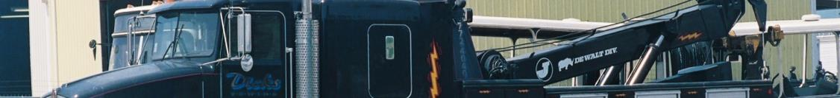

Field of applications
Construction & Infrastructure
Long distance tracking
Vehicle recovery services
Adventure & recreational vehicles

Slide 4
Customers applications
Fleet management: PTC
Tachograph download: DAKO
Alcohol Level Monitoring: Dräger
Roller door management: T-System
Car-Sharing: RAM/Alphabet/Audi
Real time online tracking: PTC, RAM
Refrigerated vehicles monitoring: Connexa (7Telematics)
Construction vehicles monitoring: Bickert Bau, Ubinam
Precision Farming: Hansenhof, LACOS
Public Transport Monitoring: DTC
Driver identification & management: SinFic, ROAMWORKS
Driving behaviour / Eco-Drive monitoring: ROAMWORKS, DTC
Cash transport vehicles monitoring: VecCtor
Waste management: moba, ARKA, SOMA, Altares
Car theft protection: Bickert Bau, Exotic
TPMS: Continental, RL-AUTO
Shipping companies: PTC, Ubinam

Slide 5
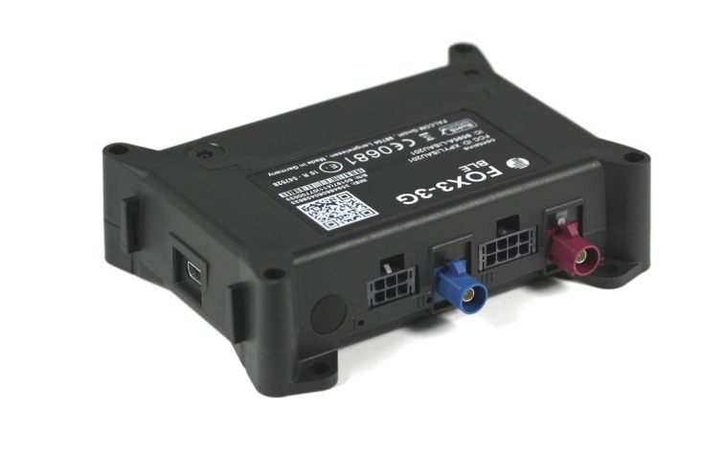
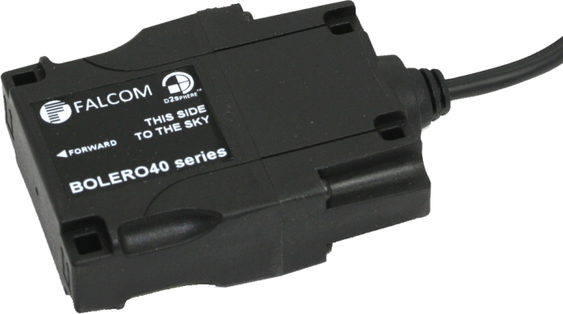
Introduction to product portfolios – Main Products
FOX3-2G/3G/4G Series
BOLERO40 Series
Same firmware
Fleet Management
Trackers / Monitoring
Full-featured hardware
Full-featured software with LUA support
Internal backup battery (optional)
Internal antennas / external antenna connectors
1-Wire interface
Audio interface
I²C interface
Flexible extension options (IOBOX-MINI/-CAN/-WLAN)
2 x Vehicle diagnostic interfaces - CAN OBDII/FMS/J1939
- Limited hardware features
Full-featured software with LUA support
Internal backup battery
Internal antennas
1-Wire interface
Dual-SIM
Confidential – for partner only

Slide 6
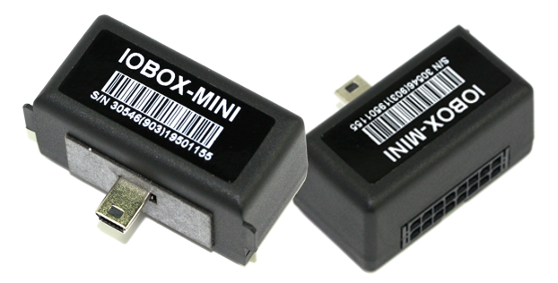
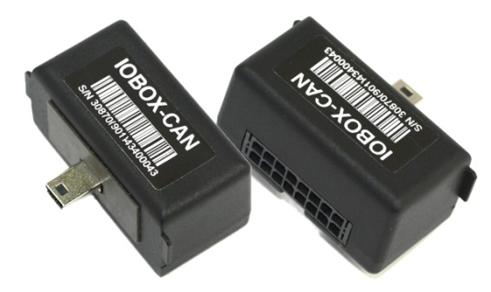
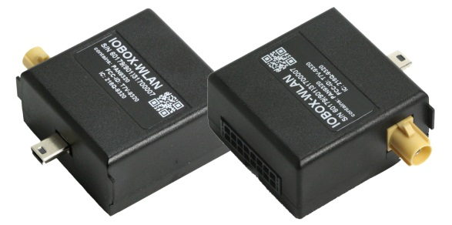
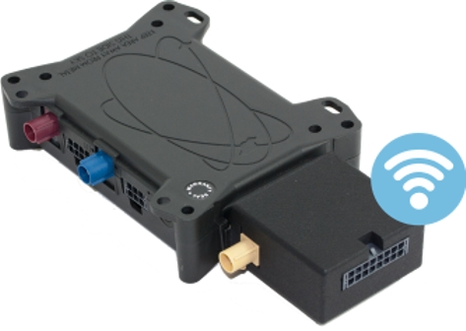
Introduction to product portfolios – Accessories
IOBOX-MINI
IOBOX-CAN
IOBOX-WLAN
I/O expansion box
CAN and I/O expansion box
WLAN, CAN and I/O expansion box
8 x Digital Inputs
4 x Digital Outputs
1 x Analog Input
CAN/FMS/OBD-II support
4 x Digital/Analogue Inputs
4 x Digital Outputs
1 x D8 info interface (IO4)
WLAN 8.02.11 n/b/g 2.4GHz
WLAN client with 5 profiles
CAN/FMS/OBD-II support
4 x Digital/Analogue Inputs
4 x Digital Outputs
1 x D8 info interface (IO4)
Confidential – for partner only

Slide 7

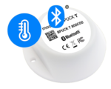
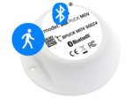
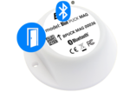

Introduction to - 3rd party products
Bluetooth Low Energy Beacons (supported with FOX3-3G-BLE using LUA script)
BLE sensor for identifica-tion of trailers, containers
BLE sensor for monitoring temperature
BLE motion sensor for detecting vibration levels
BLE sensor for detecting open and close
- High transmission range: up to 500 meters (open field)
- Lifecycle: up to 20 years
- ID, MOV, MAG, T, iBeacon (Apple) compliant
- Integrated NFC chipset (for programming)
- Robust industrial casing - IP68 waterproof
- Operating temperature: -40°C to +85 °C

Slide 8

Product Overview – PFAL Script, fully customizable
LOGGING
log out-of-coverage
locations and events
SPEED
Periodic or
threshold-based alerts
COMMUNICATIONS
Configurable reporting rate based on motion, time and/or input state change
ACCESSORIES
1Wire/PND/Sensors/RFID reader
COUNT
Trigger when discrete
actions exceed limit
(e.g. door openings)
ECO-DRIVE
Configurable alerts on braking, acceleration, cornering, with crash detection and logs
POWER MANAGEMENT
Configurable sleep and wake
periods based on elapsed time
and/or monitored state change
ZONES
Report border crossings

Slide 9

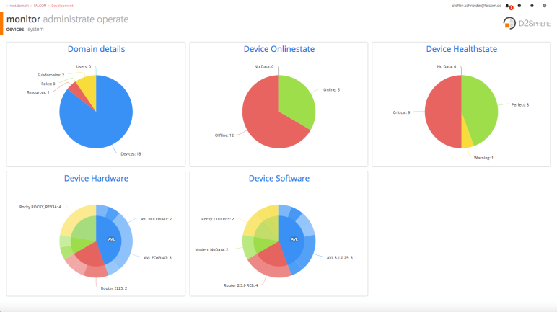
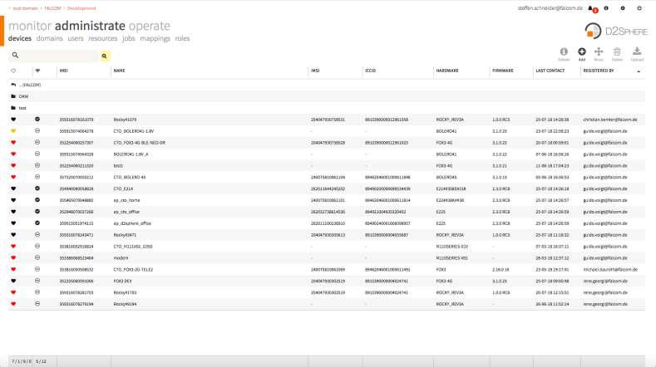
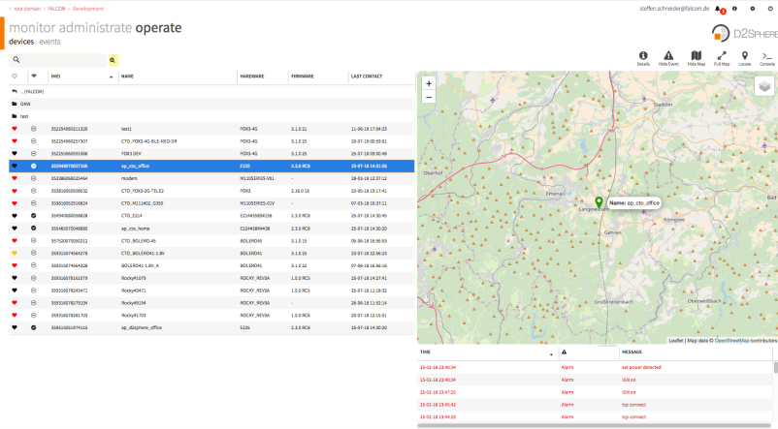
Product Overview – Device Management platform
D2Sphere: free testing platform
Online status
Real time tracking
Alerts and notifications
Reporting
User / group / device management
Tracking / visualisation / status information
Basic & advanced configuration
Event handling
History management
Device & server history
Trip presentation
Geofence management
Internationalisation & Localisation
Supported browser: Firefox 3.6, Opera 10.6, Internet Explorer 9, Safari 4, Chrome 8 or newer versions

Slide 10
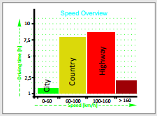
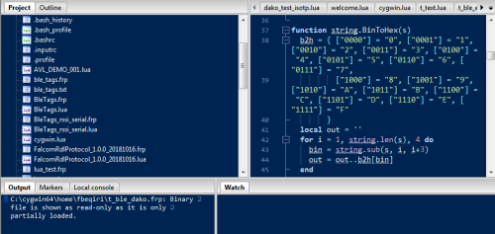
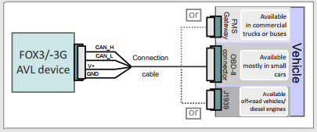
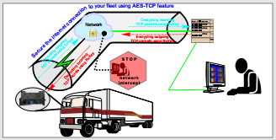
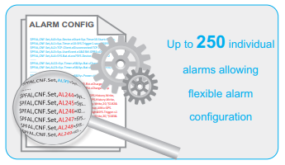
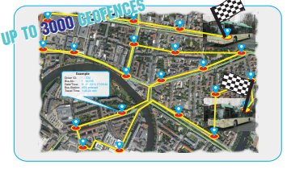
Introduction: Premium Features
Premium - Features
Interfacing FOX3/-3G device to vehicle CAN-Bus
Business modeling and analysis based on the ECO-DRIVE data reported via OTA
LUA script enables the collection and transformation of data into readable format for remote server
AES data encryption for fleet security solutions
Up to 250 individual alarms allowing flexible alarm configuration
Create up to 3000 Geofences i.e. for bus tracking and logistic projects

Slide 11

Product Overview – Data logging functionality
Benefits
Embedded 8MB flash
3,5MB flash free for storage (up to 1Mil records)
1MB flash for TCP buffer
Sending buffered data automatically or upon request
Black-box (accident detection)
Driver’s Logbook
Never loose a fix…
Never loose an event…
…even where there is no cellular coverage available
Can be retrieved at any time, automatically and on demand

Slide 12



Product Overview – Communications
Benefits
Different channels (SMS, TCP, UDP)
Push thru mode (Serial to TCP and vice-versa)
2G/3G/4G connectivity
White and black list operator
Easily adapting to user’s application requirements.
Reporting (google link) to smart phones independent from server.
SMS as a backup

Slide 13


Product Overview – Speed
Benefits
Periodical speed reporting
Multiple over-speed alert / threshold
Multiple over-speed duration / counter
Combination of speed with coordinates data and date, time, heading and other parameters
Statistics for driving behavior
Reducing fuel consumption
Saving money
Climate protection
Safety by reducing accident rate
Reduced maintenance

Slide 14


Product Overview – Driver behaviour
Satellite-based GNSS feature with a sophisticated algorithm
Fuel consumption (l/100km)
CO2 emission (g/km)
Driving behaviour: harsh brake/acceleration/turn/ overspeed
Speed monitoring in 3 different Topologies (city, country, highway)
Independent from CAN and wiring
Vehicle parameters should be configured
Benefits
Reduce fuel consumption
Saving money
Reduce noise and air pollution
Educate drivers
Reduce risk of accidents

Slide 15


Product Overview – Timers
Benefits
GNSS Time / RTC / Time sync. via server
Define action(s) to be executed at specific time AND/OR time frame (Year, Month, Mday, Week, Wday, Hour, Minute, Sec.)
Prevent actions to be executed at specific time AND/OR time frame
Alert/Notification when scheduled working time is exceeded
Defining the working days/hours of the week
Immobilizing the vehicle beyond working time
Business and private vehicle usage
Monitoring overtime work
Car-sharing reservation
Antitheft

Slide 16




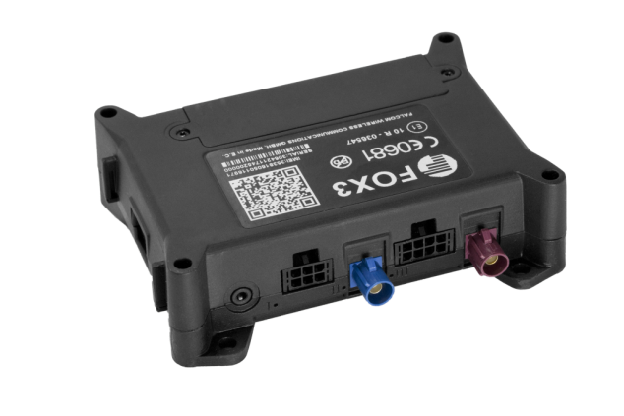
Product Overview – Input / Output Ports
Digital Output
Digital Input
Analogue input
Private mileage
Benefits
Access control functions (e.g. door open/close, engine start/stop)
Vehicle Monitoring (e.g. fuel level sensors, battery performance, etc.)
SOS Alerts using digital input
Business and Private mileage count using digital inputs
SOS alerts
Business mileage

Slide 17
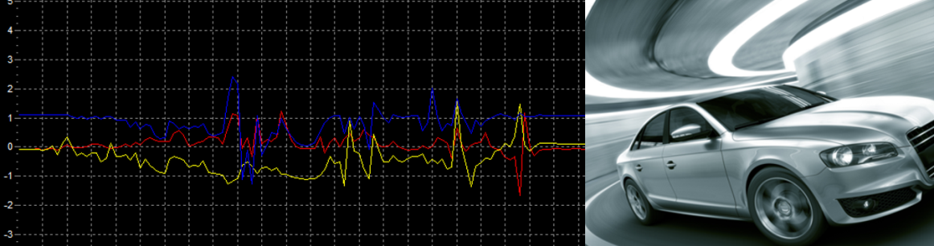

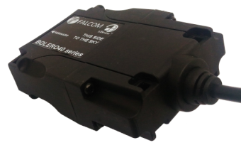
Product Overview – 3-axis Accelerometer
Moving
Standing
Harsh braking
Harsh acceleration
Z
Benefits
X
Accident, Harsh braking and acceleration detection
Vehicle moving and stationary detection
Three dimensions measure acceleration
Sensitivity configurable
Determine vehicle orientation e.g. tilting etc.
Y

Slide 18


Product Overview – Ignition Sensing
Benefits
Towing detection alerts
Digital input detects engine ignition and alert to owner
3-axis accelerometer detects movement without engine ignition, then sends an alert to the owner.
Park area alerts when engine ignition is off and vehicle moves out of this area
GNSS function activated for tracking and recovery
Trip start and stop detections
Trip start and stop detections

Slide 19

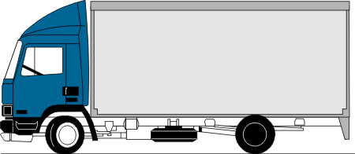

Product Overview – 1-Wire monitoring
Benefits
Key control / i-Button
Temperature sensor
Real-time temperature monitoring in refrigerated trucks during transportation
Support i-Button for driver ID
Manage driving hours

Slide 20


Product Overview – Power Management
Benefits
Multi power-saving modes
Configurable sleep modes with different sleep parameters
Sleep modes: Motion, Timer, IGN, Power detect, Ring, Power drop, LowBat
Combination of sleep parameters
Doze mode (on/off): CPU and GNSS hibernate; GSM on
Auto mode: GSM, GNSS, CPU stand-by depending on load
Battery smart charge and battery monitoring: temperature, state, voltage
Reduce power consumption
Prevent drain of vehicle battery
Extend operating time on internal battery

Slide 21

Product Overview – Geofences
99 Geo-Fences (circular/rectangular)
32 areas (selective, combination)
1 parking area (circular)
2,000 waypoints (corridor)
3,000 Geo-Fences (circular)
Alerts/notification when entering/exiting Geo-Fence
Remote Configuration / Update
Server independent / stored on device
Benefits
Theft protection
Stay on course
Optimum monitoring
Shipment notification
Cut down on inappropriate vehicle use
Reduce roaming costs
Generate notification when destination reached

Slide 22

Product Overview – Triggers
Benefits
40 Counters / 40 Triggers (high/low)
Counter value can be set, reset by user or automatically
Triggers are used for PFAL configuration only, as additional conditions for alarms
Counting certain events or combinations of various states
Pulse counting for power meter and fuel flow meter
No need for counter algorithm on server side
Statistic for various events
Simplify device configuration with PFAL script

Slide 23




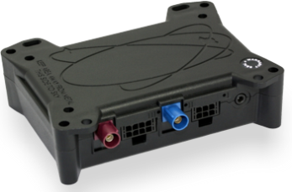
Success Story - Mobile Alcohol Level Monitoring
Benefits
Device: FOX-EN/FOX3-4G
Customer: Dräger Safety/ Werk
Location: USA, Nordics
Deployed:
FOX-EN: > 15.000 pcs
FOX3-4G-NA: > 5.000 pcs (in progress)
Reducing accidents by driver verification
Latest connectivity technology
Intelligent camera controlled
Customized firmware protocol (Interlock® )
Car immobilization

Slide 24


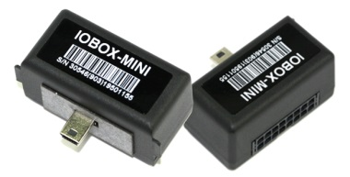
Success Story – Car Sharing
Benefits
Product: FOX-EN, FOX3-2G/4G
Customer: RAM
Location: Netherlands / Belgium
Deployed: > 3,000 pcs
Online car reservation
Customized applications for car sharing
RFID member card and iButton for identification
Real time mileage
Use vehicle diagnostic data
Eco-drive implemented
Fleet maintenance

Slide 25
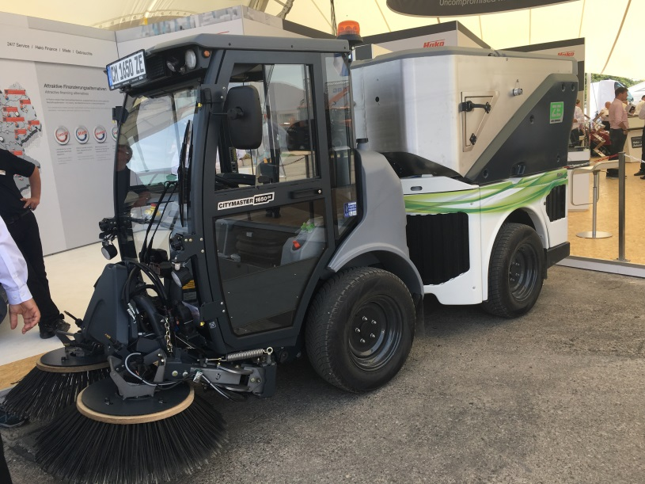
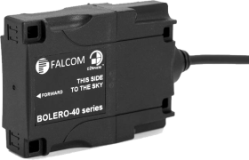


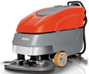



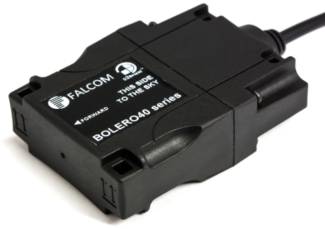
Success Story – Remote configuration and maintenance
Benefits
Forward the data to their SAP system thru D2Sphere
Recording working hours of cleanining machines
Recording working hours of accessory parts
Device and data management
Battery management
Protocol integration with LUA
Invoice digitalization
Complete solution (incl. D2Sphere, Lua, SLA)
Mobile connectivity
Product: FOX3-4G/BOLERO41/BOLERO45
Customer: HAKO
Location: Germany with worldwide use
Deployed: In progress ( > 50pcs being tested)

Slide 26
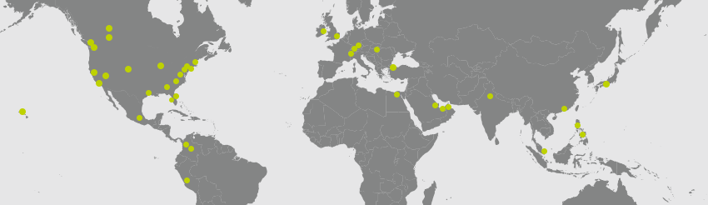

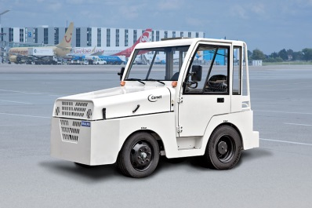
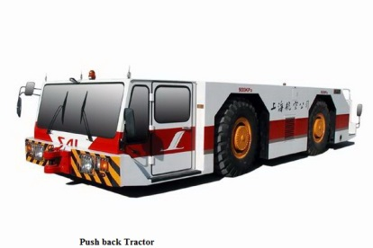
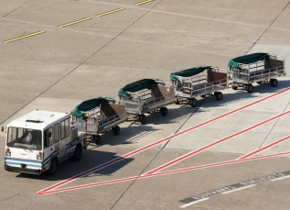
Success Story – Airport Asset Telematics
Benefits
Product: FOX3-3G
Customer: Quantum
Location: Germany with worldwide use
Deployed: 1000 pcs
Real-time data through Telematics for immediate operations
Provides current and precise data through Telematics technology
Determine if an asset has its ignition switched on when it shouldn’t
Tracking luggage from point A to point B
Vehicle diagnostic data (CAN, FMS, OBDII)
Delivers valuable, customizable reporting information
RFID/BLE/iButton for asset and driver identification
WLAN communication with hidden SSID (PoC approved)
Operating at airports on 4 continents

Slide 27


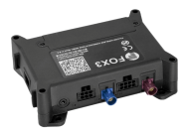
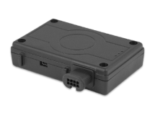
Use-Cases – Public Transport
Benefits
Product: FOX3, FOX-IN/EN
Customer: Delhi Transport Corporation
Location: India
Deployed: 6000pcs
Bus schedule Management
optimization of bus routes
Bus arrival forecast
Traffic-jam detection
Speed control
Driver education
Engine parameter monitoring using CAN

Slide 28










Partners – Platform, Hardware, Technology
Global Platform
Sensors, hardware
Technology

Slide 29
Competitors – The best products
Why we are better than the competitors ?
Customized
(OEM)
CalAmp
Many customers don't care too much about getting the perfect product,
but a big group of customers want to make sure they are making the best choice.
Device
Services
Teltonika
Our products
Product features
Ruptela
Device
Support
Aplicom
Same firmware

